Slide 1
Agile Product Development: A Journey Through Uncharted Waters
Diliny “DCOR” Corlosquet
Senior Product Manager, BioRAFT

Slide 2
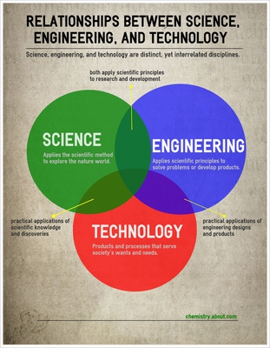
About me
Email: Diliny.corlosquet@bioraft.com
Drupal: dcor
Twitter: dcorlosquet
Background
Chemical Engineering, MASc, MSc
10+ years laboratory research
5+ years Front-End Drupal Web Development
2+ years Product Management

Slide 3
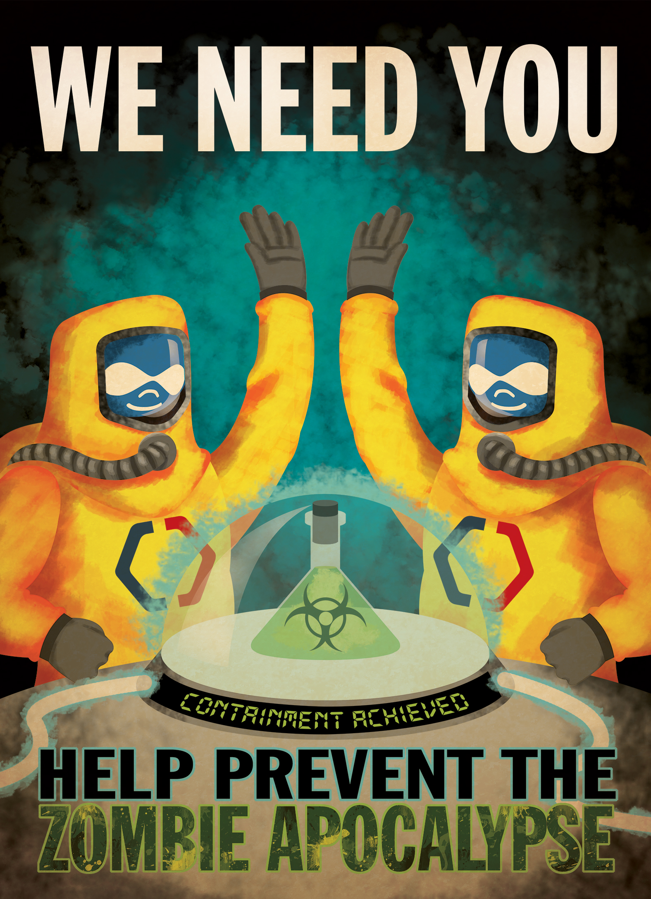
BioRAFT
Research Management System
Reporting research
Identify hazards and exposures
Providing essential training

Slide 4
Agile Manifesto
Individuals and Interactions over Processes and Tools
Working Software over Comprehensive Documentation
Customer Collaboration over Contract Negotiation
Responding to Change over Following a Plan

Slide 5
Body of Water: Our Backlog
New Module Development
Break to smaller grouped tasks
Support Requests
UX fixes, bugs
Feature Requests
Enhancements
Backlog
Product Debt
Technical Debt
Known Bugs
Tasks are defined as
Granular tasks
Grouped tasks affecting a single feature
Grouped tasks involving a single module
We run a 1 month long release cycle
Tasks are defined at the beginning of the release via their priority
Approximately 3 weeks of development
1 week testing
Urgent items, “Release overflow”
Patch as often as required

Slide 6
Agile vs. Waterfall
Agile
Waterfall
Specifications & Requirements are defined
Development steps are planned in phases
Product is delivered in phases
End goal is known but the final outcome may be more optimal to the product than originally planned
Requirements and specifications are defined
Each development step is predefined prior to commencing work
Product is delivered once all requirements and specifications have been met.
End goal is expected in every detail

Slide 7
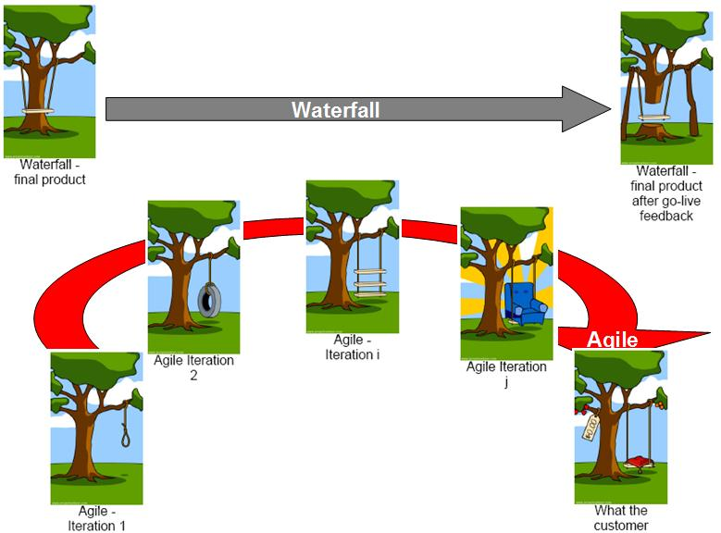
Credit: http://www.guerillaprojectmanagement.org/

Slide 8
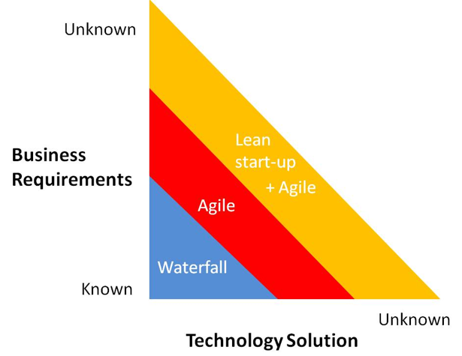
In reality, it’s a combination!
Agile Tasks
Waterfall Tasks
New Module development
Clean up of Product/Technical Debt
UX bug fixes
Implementation Tasks
Support fixes
Bug fixes
Final actions on New Modules (cleanup)

Slide 9
Navigation: How we prioritize tasks
Long term development pipeline
Prediction on a monthly/quarterly basis of what we hope to accomplish for the year
Support Requests
Implementation needs
Client requests prioritized
Bugs

Slide 10
FirstRAFT: Setting off with the minimum
Tools used
Basecamp
Process during release
Defined list for release
Prioritization by order
Move items to another list when completed
Inconsistent documentation when needed
Process during testing
Test and confirm
Check complete

Slide 11
Basecamp: Patch

Slide 12
Basecamp: A Release
Release Defined by
Major Features
Bugs
General
Typos/Quick Fixes
Configurations

Slide 13
Rational – Small Team
The Good
The Bad/Ugly
Small team means everyone is aware of what everyone else is doing – no silos
Everyone involved is an ‘expert’ on all facets of the product
Review each other’s work in real-time
Critical commits visible on development servers for testing
Manage all tasks on one page
Checking off the item meant it was ‘done’
Little time for QA - final testing and no code review
No evidence based QA testing
Bugs and technical debt rampant
Often the patch following a release involves major bug fixes
Lower priority items move from release to release or worse, as priority escalates to a patch!

Slide 14
… and then our team expanded

Slide 15
Small Storm on the Horizon:
The Good
The Bad/Ugly
More tasks being completed
More testing and QA required
Utter confusion for the newbie coming on to the ‘hacked’ basecamp system

Slide 16
Keep building your RAFT: Optimizing the development process
Take stock of where you are
Take a small step towards your goal
Learn
Adjust based on what you learned
When faced with two or more alternatives that deliver the same value, take the path that makes future change easier

Slide 17
Changes to the process!
Introduction of screenshots for QA of process
More hacks to basecamp:
Documentation around the processes for clarity (Basecamp descriptions on list)

Slide 18
And we expanded again… and again…

Slide 19
Keep building your RAFT:
Take stock of where you are
Take a small step towards your goal
Learn
Adjust based on what you learned

Slide 20
Tsunami of a challenge
The Good
The Bad/Ugly
More tasks being completed
Silos of work
More testing and QA required
Utter confusion for the newbies coming on to the ‘hacked’ basecamp system

Slide 21
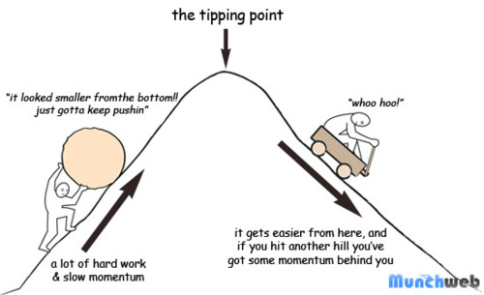
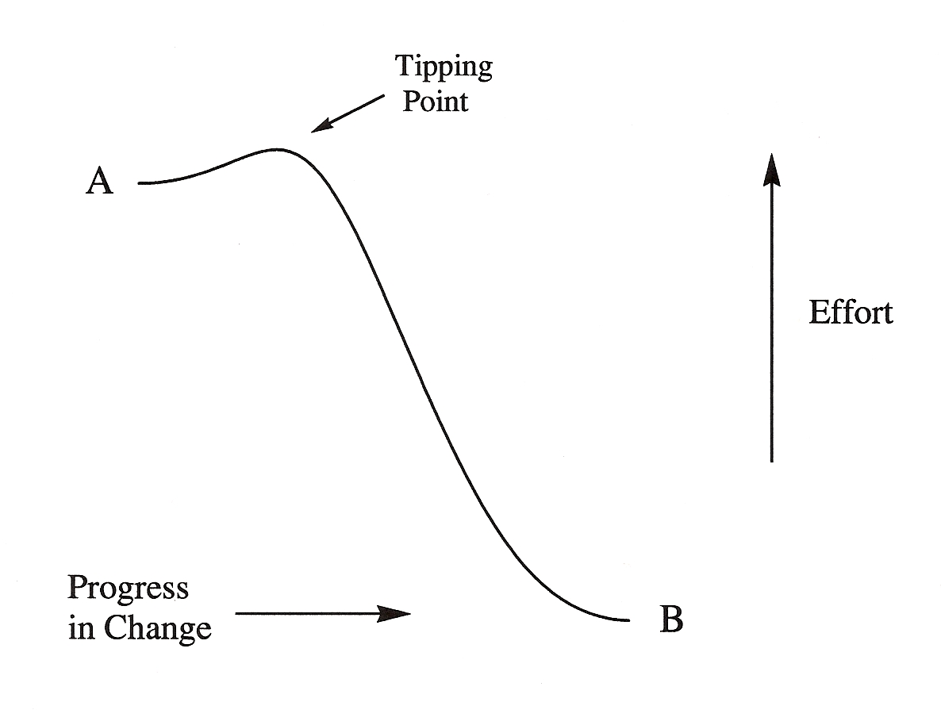
Time to sink or to swim?
Individuals and Interactions over Processes and Tools
Working Software over Comprehensive Documentation
Customer Collaboration over Contract Negotiation
Responding to Change over Following a Plan

Slide 22
Trello: NewRAFT
To Do
Doing
Second Round Testing
Done
Final Confirmed

Slide 23
TRELLO Boards for managing tasks
Major Tasks
Backlog
RELEASE
PATCH
Client Requests

Slide 24
Safe Harbors for Start-Ups & Distributed Teams
As a start-up, whatever structures are in place
Need to be maintained (manpower)
Need to be easy
Need to be rationalized
Build infrastructure ONLY when you absolutely need it – wait for the tipping point

Slide 25
Safe Harbors for Start-Ups & Distributed Teams
Utilize the skills of your development team
Build on your team’s strengths
Senior walking encyclopedias
Nurture developers with OCD tendencies
Share knowledge via shared tools, case studies, mentorships
Code Reviews
Developer feedback on specifications

Slide 26
On the horizon:
Improvements
Potential Tools
Link tickets together (sibling, parent/child)
Link code commits to tickets
Link planning docs to tickets
Custom fields
Custom workflows
Advanced search options

Slide 27
Smooth sailing (or is it?)
Larger Crew
Distributed Team
What are we missing?
Communication

Slide 28
Smooth sailing (or is it?)
Importance of Documentation
Initial Specifications
Feedback/Cross-talk during implementation
Changes to specifications (the what we can and can’t do)
Documenting Code
Documenting acceptance criteria, test paths, etc.
Testing
How to test…
When to test…
What to test…
Who to test as…
Who is responsible?

Slide 29
Maps: The Importance of Documentation
Credit: http://www.targetprocess.com/

Slide 30
Maps: The Importance of Documentation
Credit: http://www.targetprocess.com/

Slide 31
Documentation in the Code

Slide 32
A picture is worth 1000 words

Slide 33
Man Overboard: Testing

Slide 34
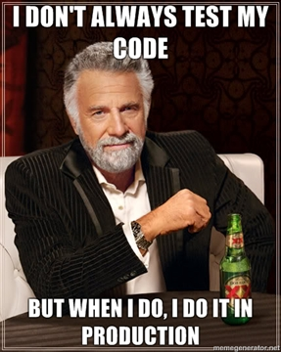
Man Overboard: Testing

Slide 35
How to get developers to test
Be prepared to work closely with developers. The majority of the testing effort is performed by the agile delivery team itself, not by independent testers.

Slide 36
How to get developers to test
To Do
Doing
First Round Testing
Code Review
Second Round Testing
Done
Final Confirmed
[---------------TESTING------------------]

Slide 37
Testing is part of the Agile process
Check basic specifications are met
Developer is tasked with ensuring test path matches the specifications
Ensure minimal technical debt moving forward via peer code reviews
Coding to Drupal Standards
Code appropriately documented
Perform sanity check of 2nd round testing

Slide 38
Testing is part of the Agile process
Peer Review ensures at least two members of the development team understand the task and acknowledge that specifications have been met
Take lots of screenshots!
Good test practices make the transition to automated testing easy

Slide 39
Take Home
Appreciate both Agile & Waterfall
The challenges of a small team are very different than those of a large team
Wait for the “Tipping Point” before introducing more complex processes/infrastructure
Retrospectives work – use feedback to improve processes
The importance of documentation
How to get your development team to test the product (and not in production!)

Slide 40
References
Freestanding Agility: http://www.freestandingagility.com/
Agile & Scrum Fundamentals
Product Owner Skills
Scrum Master Skills
Time to Kill Agile, Thomas D., March 4th 2014, http://pragdave.me/blog/2014/03/04/time-to-kill-agile/
Rolling Wave User Stories: How to handle specifications http://www.targetprocess.com/blog/2013/08/rolling-wave-user-stories-how-to-handle-specifications.html
Agile Testing: http://www.ambysoft.com/essays/agileTesting.html
Contact me: diliny@BioRAFT.com
Drupal.org: dcor
Slides: http://www.drupalnights.org

