Slide 1
From User Personas to Testing A Project Manager’s Journey Towards Behat
Michelle Lauer
D4D Boston
Friday, Aug 1, 2014 - 2:15pm

Slide 2
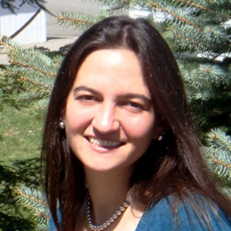
Michelle Lauer
Technical Project Manager at BioRAFT
Drupal Developer since the D5 days
Organize the Manchester NH Drupal Meetup
Contributing author of DGD7
Organize drupalnights.org
drupal.org/u/miche
twitter.com/bymiche

Slide 3
BioRAFT
The BioRAFT platform is a scientific research management system that provides an integrated portal, compliance oversight, and productivity solutions.
SAS, multi-site application
WE’RE HIRING!
Technical Project Manager
bioraft.com

Slide 4
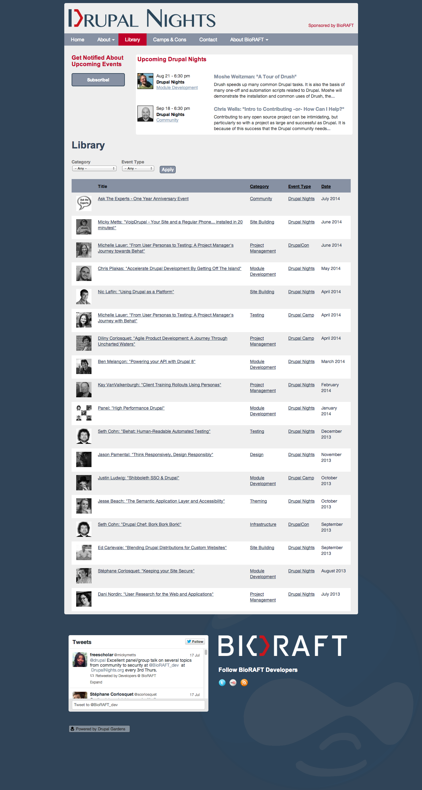
Live presentations on the third Thursday of every month in Cambridge, MA
Information for all types of web professionals working with Drupal
Growing library of video, slides and links from past Drupal Nights and BioRAFT employee sessions at Camps & Cons
drupalnights.org

Slide 5
The Journey
Problem
Existing Technical Debt
New Bugs
Manual QA Testing
Research
Continuing Education
The Light Bulb Moment
Solution
User Personas
User Journeys
User Stories
BDD
Behat

Slide 6
The Journey
Problem
Existing Technical Debt
New Bugs
Manual QA Testing
Research
Continuing Education
The Light Bulb Moment
Solution
User Personas
User Journeys
User Stories
BDD
Behat

Slide 7
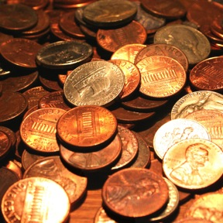
Existing Technical Debt
Things you could fix now but will do later at a higher cost.
Business pressure to release quickly
Lack of building loosely coupled components
Delayed refactoring
Lack of documentation
http://www.freeimages.com/photo/884054

Slide 8
Existing Technical Debt
Accept decisions made in the past
Address issues when they arise
Refactoring
Slow path to reducing
Make new decisions to not create more debt
Write more loosely coupled code
http://www.freeimages.com/photo/884054

Slide 9
The Journey
Problem
Existing Technical Debt
New Bugs
Manual QA Testing
Research
Continuing Education
The Light Bulb Moment
Solution
User Personas
User Journeys
User Stories
BDD
Behat

Slide 10
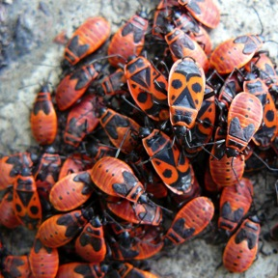
New Bugs
Complicated code
Small change in one section can affect another section
Challenging to catch
Until it is too late
Peer Code Reviews
http://www.freeimages.com/photo/1182513

Slide 11
The Journey
Problem
Existing Technical Debt
New Bugs
Manual QA Testing
Research
Continuing Education
The Light Bulb Moment
Solution
User Personas
User Journeys
User Stories
BDD
Behat

Slide 12
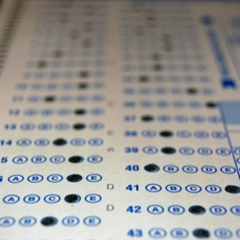
Manual QA Testing
Per ticket
Did it meet the spec?
Did it break anything else?
Going through each of the site verticals
Blog section, search pages, etc.
Challenges
Repetitious
Time Consuming
Inconsistent
http://www.freeimages.com/photo/517386

Slide 13
The Journey
Problem
Existing Technical Debt
New Bugs
Manual QA Testing
Research
Continuing Education
The Light Bulb Moment
Solution
User Personas
User Journeys
User Stories
BDD
Behat

Slide 14
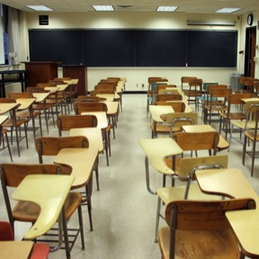
Concurrent Continuing Education
1-day course: “Agile & Scrum Fundamentals”
User Stories
Atlassian Webinar: “Do Agile Right”
User Personas
User Journeys
DrupalNights: “Behat – Human Readable Automated Testing”
Behat
http://www.freeimages.com/photo/1193228

Slide 15
The Journey
Problem
Existing Technical Debt
New Bugs
Manual QA Testing
Research
Continuing Education
The Light Bulb Moment
Solution
User Personas
User Journeys
User Stories
BDD
Behat

Slide 16
Light Bulb Moment
Culture of Quality
Code Reviews
Manual QA Testing
Automatic Data Validity Checks
New Perspective, New Goals
Focus on Business Value
Varied Users/Roles/Permissions
Consistent Test Coverage
Easily Repeatable Tests
http://www.freeimages.com/photo/472591

Slide 17
Light Bulb Moment
Solution
User Personas
Varied users/roles/permissions
User Journeys
Focus on business value
User Stories
Noting individual tasks provide consistent feature coverage
Automated Acceptance Testing
Easily repeatable tests
http://www.freeimages.com/photo/472591

Slide 18
The Journey
Problem
Existing Technical Debt
New Bugs
Manual QA Testing
Research
Continuing Education
The Light Bulb Moment
Solution
User Personas
User Journeys
User Stories
BDD
Behat

Slide 19
User Personas
Fictitious characters that represent each different type of person that visits your site.
“The purpose of a persona is not to describe the tendencies of a group of people defined by age, sex, race & income, but instead to describe the behaviors of a specific person who represents a class of needs and goals.” –Dan Brown
http://www.freeimages.com/photo/1338872

Slide 20
User Personas
Define your segments
Donors, volunteers, email subscribers, inactive members, paid members
Define your demographics
Age, sex, income, level of education, have children
Only the ones that matter
Articulate their values & beliefs
Hobbies, political persuasion, goals, personality characteristics
http://www.freeimages.com/photo/1338872

Slide 21
User Personas
Get into their skin
Self-image, day-to-day worries, habits
Define the value they get from your organization
Why do they share posts, leave comments, donate money?
What roles/permissions do they have?
Admin, super-user, paid member, free member
http://www.freeimages.com/photo/1338872

Slide 22
User Personas
What tasks do they commonly complete?
Uploading photos, rating content
Give them a face and a name
“The process of discussing how these personas feel, think and behave will give you information that you'd never be able to get if you used only your subjectivity.” – John Haydon
http://www.freeimages.com/photo/1338872

Slide 23
User Personas

Slide 24
User Personas

Slide 25
User Personas

Slide 26
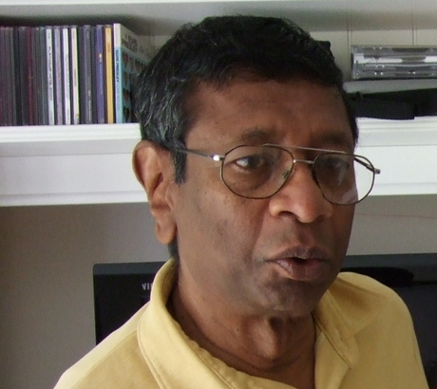
User Personas
Tagline
“I want to be a resource to the researchers, not the safety police.”
Position
Environmental Health & Safety Director
Character Traits
Intelligent, Enthusiastic, Bold, Persevering, Achiever

Slide 27
User Personas
Role in BioRAFT Rodger manages the Earth EH&S Department and oversees all compliance activity via BioRAFT. He manages teams of auditors, conducts audits himself, and attends to a variety of compliance duties as necessary. Most of the time he delegates work to people on his team.

Slide 28
User Personas
Tasks in BioRAFT
Views Dashboards
Views Inspection Logs
Schedules Inspections
Monitors Bio & Chem & Rad Registrations
Oversees Lifesafety

Slide 29
User Personas
Common Access/Job Activities
Edit Basic Group Information￼
Edit Group Biological Information￼
Edit Group Chemical Information￼
Edit Group Equipment Inventory￼
Compliance Officer
EHS
View Institution Biological Information
Manage and Approve Biological Registrations
View Institution Chemical Information
Manage and Approve Chemical Registrations
Manage Radiological Licenses and Inventory
Manage Radiological Waste Collection

Slide 30
User Personas

Slide 31
User Personas

Slide 32
The Journey
Problem
Existing Technical Debt
New Bugs
Manual QA Testing
Research
Continuing Education
The Light Bulb Moment
Solution
User Personas
User Journeys
User Stories
BDD
Behat

Slide 33
User Journeys
Go from putting on your user’s hat to walking in the user’s shoes
Start with a Persona and a goal on the website
Plot all actions to complete goal
Mark whether task is easy or hard
http://www.freeimages.com/photo/1005079

Slide 34
User Journeys
Aggregate user paths & user challenges to prioritize feature enhancements.
Which pages are hit frequently?
Which actions happen often?
Which tasks are challenging?
http://www.freeimages.com/photo/1005079

Slide 35
User Journeys
https://www.youtube.com/watch?v=fsviy3ai9Dw

Slide 36
User Journeys
http://www.pinterest.com/robertleotta/user-journeys/

Slide 37
User Journeys

Slide 38
User Journeys

Slide 39
User Journeys

Slide 40
User Journeys
Possible Categories for Steps
Discover, Pre-Engagement
Investigate, Prepare
Action, Apply
Completion
http://www.freeimages.com/photo/1005079

Slide 41
User Journeys
Level of Frustration
Range of 5
Happy, Neutral, Sad
Identify Pain Points
Pay attention to support requests
Interview real users, including your team
http://www.freeimages.com/photo/1005079

Slide 42
The Journey
Problem
Existing Technical Debt
New Bugs
Manual QA Testing
Research
Continuing Education
The Light Bulb Moment
Solution
User Personas
User Journeys
User Stories
BDD
Behat

Slide 43
User Stories
Description of a feature from the perspective of the person who will be using it.
The value comes from putting the user’s experience first.
Helps you understand “why” you are building a certain feature.
http://www.freeimages.com/photo/1068821

Slide 44
User Stories
As {type of user}, I want {some goal} So that {some reason}.
http://www.freeimages.com/photo/1068821

Slide 45
User Stories
As an EH&S Director, I want to check the inspection schedule for tomorrow, So that I know what to expect.
As {type of user}, I want {some goal} So that {some reason}.
http://www.freeimages.com/photo/1068821

Slide 46
User Stories
As an EH&S Director, I want to schedule an inspection, So that the inspectors know what their tasks are.
As an EH&S Director, I want to schedule an inspection, So that the lab managers are prepared for the inspections.
As {type of user}, I want {some goal} So that {some reason}.
http://www.freeimages.com/photo/1068821

Slide 47
User Stories
As a member, I want to upload photos, So that I can share photos with others.
As an administrator, I want to approve photos before they are posted, So that I can make sure they are appropriate.
As {type of user}, I want {some goal} So that {some reason}.
http://www.freeimages.com/photo/1068821

Slide 48
The Journey
Problem
Existing Technical Debt
New Bugs
Manual QA Testing
Research
Continuing Education
The Light Bulb Moment
Solution
User Personas
User Journeys
User Stories
BDD
Behat

Slide 49
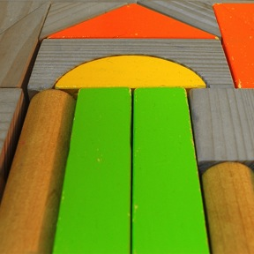
Behavior Driven Development (BDD)
Specialized version of test-driven development which focuses on behavioral specification of software units.
define a test set for the unit first
implement the unit
verify that the implementation of the unit makes the tests succeed
Excerpted from wikipedia.org
http://www.freeimages.com/photo/585286

Slide 50
Behavior Driven Development (BDD)
BDD specifies that business analysts and developers should collaborate in this area and should specify behavior (aka tests) in terms of user stories.
Direct correlation between the User Story a project manger writes and and a BDD Test that a developer writes.
http://www.freeimages.com/photo/585286

Slide 51
Behavior Driven Development (BDD)
User Story
As {type of user}, I want {some goal} So that {some reason}.
As a member,
I want to upload photos,
So that I can share photos with others.
http://www.freeimages.com/photo/585286

Slide 52
Behavior Driven Development (BDD)
BDD Scenario
Given {initial context}, When {event occurs}, Then {some outcome}.
Given I am logged in as a member,
When I am on my profile page,
I should see a link to upload photos.
http://www.freeimages.com/photo/585286

Slide 53
Behavior Driven Development (BDD)
A file for each Feature
search.feature
photos.feature
blog.feature
http://www.freeimages.com/photo/585286

Slide 54
Behavior Driven Development (BDD)
List Scenarios
Tag Scenarios
Run only which scenarios you want.
http://www.freeimages.com/photo/585286

Slide 55
The Journey
Problem
Existing Technical Debt
New Bugs
Manual QA Testing
Research
Continuing Education
The Light Bulb Moment
Solution
User Personas
User Journeys
User Stories
BDD
Behat

Slide 56
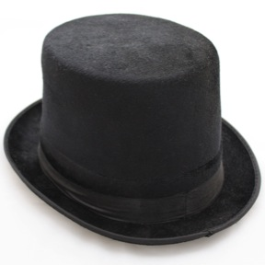
Behat
“Behat is a tool that makes behavior driven development (BDD) possible.
With BDD, you write human-readable stories that describe the behavior of your application.
These stories can then be auto-tested against your application. And yes, it’s as cool as it sounds!
Excerpted from docs.behat.org
http://www.freeimages.com/photo/1395333

Slide 57
Behat - xxx.feature
Feature: Events
In order to find events As a website user I need to be able to see them displayed
#this shows you how to test that something is displaying - specifically block title
@drupalnights @events
Scenario: See the next DrupalNights event
Given I am on "/"
Then I should see the "Upcoming Drupal Nights" block in "sidebar a" region

Slide 58
Behat - xxx.feature
Feature: Contact
In order to submit feedback
As a website user
I need to be able to fill out a contact form
#this shows you how to test if filling out a form is behaving correctly
@drupalnights @contact
Scenario: Do not submit form when required fields aren't filled out
Given I am on "/contact"
And I fill in "Your name" with "Sample User"
And I fill in "Your e-mail address" with "email@email.com"
And I fill in "Subject" with "Great site!"
And I fill in "Message" with ""
And I press "Send message"
Then I should see "Message field is required.”

Slide 59
Behat - xxx.feature
#this shows you how to test if filling out a form is behaving correctly
@drupalnights @contact @test
Scenario: Fill out all form fields
Given I am on "/contact"
And I fill in "Your name" with "Sample User"
And I fill in "Your e-mail address" with "email@email.com"
And I fill in "Subject" with "Great site!"
And I fill in "Message" with "Fantabluous!"
And I press "Send message"
Then I should see "Your message has been sent."

Slide 60
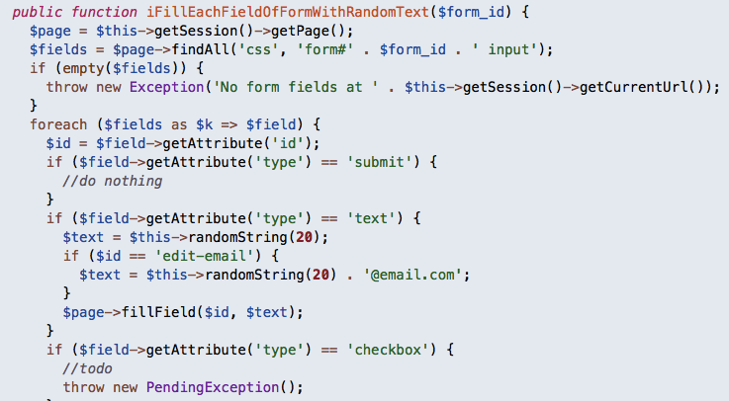
Behat – FeatureContext.php

Slide 61
Behat – Running Tests

Slide 62
Behat – Running Tests

Slide 63
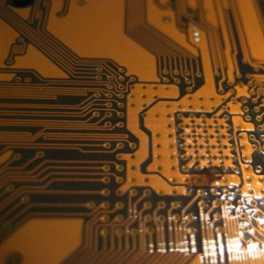
Behat - Code Coverage
What has the most Business Value?
Which Features, if taken away, would make your site essentially useless?
Examples:
Registering Logging in Customizing your profile Writing posts Leaving comments | Uploading photo Approving photos Seeing most recent articles Rating content Searching content
http://www.freeimages.com/photo/774486

Slide 64
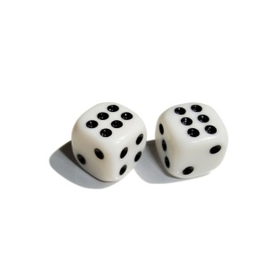
Behat - Bonus
If you migrate your site to another version of Drupal or even another platform, your Behat Scenarios will still be correct.
http://www.freeimages.com/photo/642737

Slide 65
The Journey
Conclusion
Take-Aways
Recap
Resources

Slide 66
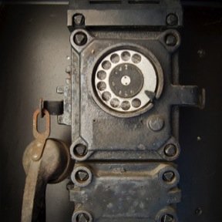
Take-Aways
Users are the most important part of a website. Put them first. Understand their needs.
Create Personas
Outline their Journeys
Define their Stories
Automate Acceptance Tests
http://www.freeimages.com/photo/1422832

Slide 67
Take-Aways
Using Agile Practices and Behavior Driven Development encourages communication between product experts and developers.
http://www.freeimages.com/photo/1422832

Slide 68
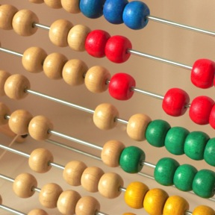
Recap
Problem
Existing Technical Debt
New Bugs
Time for Manual QA Testing
Solution
User Personas
User Journeys
User Stories
BDD
Behat
http://www.freeimages.com/photo/531969

Slide 69
Recap
Take the deliverables from best practices used in Project Management and Usability Studies.
Personas, Journeys, Stories
Use them as fodder for your Behavioral Testing.
Behat
http://www.freeimages.com/photo/531969

Slide 70
Recap
REDUCE Technical Debt
New Bugs
Time to Launch
Behavioral Testing
User Personas
User Journeys
User Stories
http://www.freeimages.com/photo/531969

Slide 71
Resources
Slides will be uploaded to DrupalNights.org!
User Personas blogs.atlassian.com & huffingtonpost.com
User Journeys blogs.atlassian.com & theuxreview.co.uk pinterest.com & pinterest.com
User Stories mountaingoatsoftware.com searchsoftwarequality.techtarget.com
BDD wikipedia.org & dannorth.net codemag.com
Behat drupalnights.org & docs.behat.org github.com metaltoad.com & metaltoad.com drupal.org & drupal.org & drupal.org drupal.org & drupal.org & groups.drupal.org drupalwatchdog.com & bdd.alexo.it
Michelle Lauer
drupal.org/u/miche
twitter.com/bymiche
bioraft.com
drupalnights.org
DGD7
http://www.freeimages.com/photo/985125

Slide 72
From User Personas to Testing A Project Manager’s Journey Towards Behat
evaluate this session
boston2014.design4drupal.org/d4d-session-schedule
Michelle Lauer
D4D Boston
Friday, Aug 1, 2014 - 2:15pm

