Slide 1
From User Personas to Testing
A Project Manager’s Journey with Behat

Slide 2
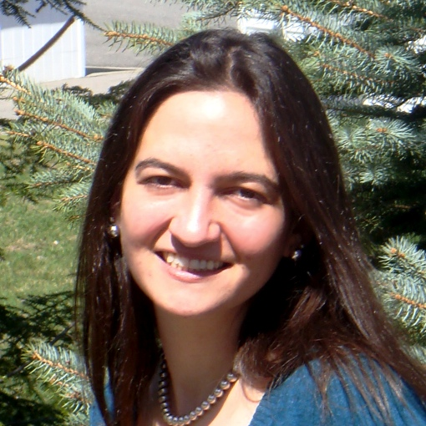
Michelle Lauer
Technical Project Manager at BioRAFT
Drupal Developer since the D5 days
Organize the NH Drupal Meetup
Contributing author of DGD7
Organize drupalnights.org
miche on D.O.
twitter.com/bymiche
drupalnights.org
DGD7

Slide 3
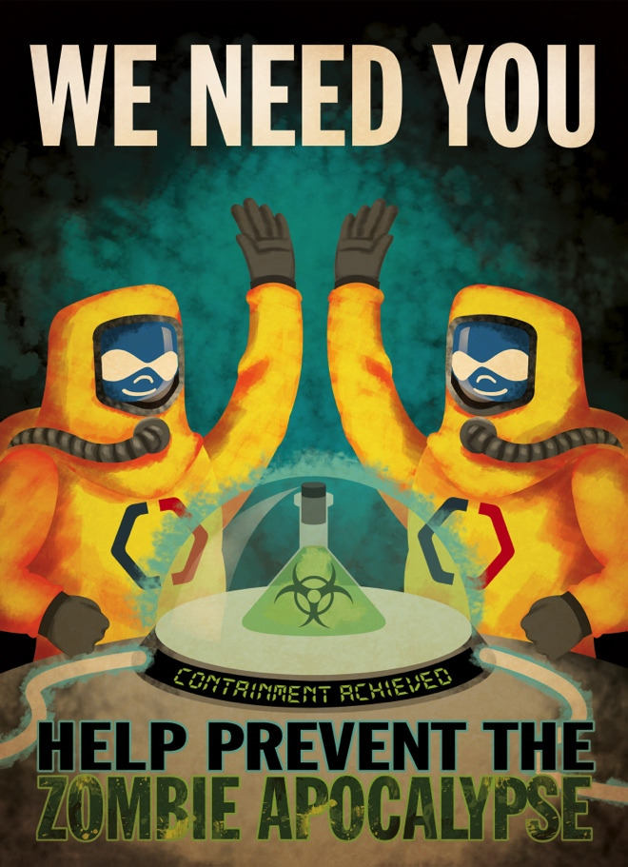
BioRAFT
The BioRAFT platform is a scientific research management system that provides an integrated portal, compliance oversight, and productivity solutions.
SAS, multi-site application.
WE’RE HIRING!
Technical Project Manager
bioraft.com
drupalnights.org

Slide 4
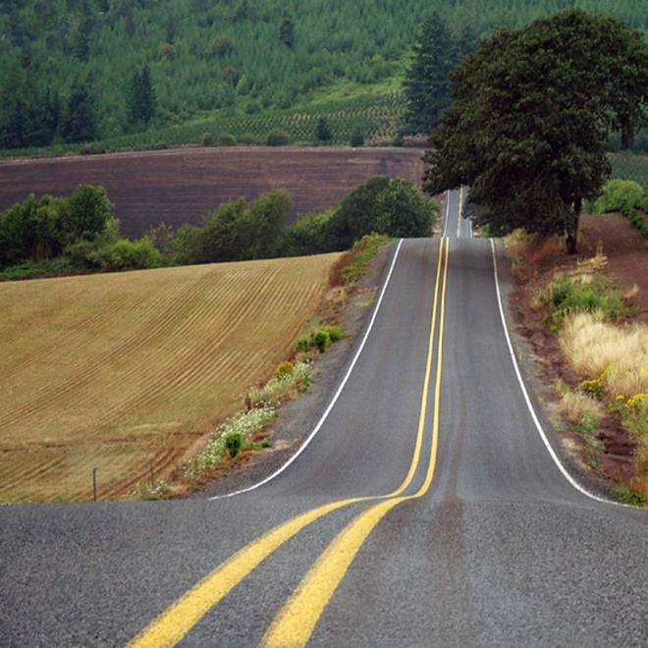
The Journey
Problem
Existing Technical Debt
New Bugs
Time for Manual QA Testing
Solution
User Personas
User Journeys
User Stories
Automated Acceptance Testing
http://www.freeimages.com/photo/1021513

Slide 5
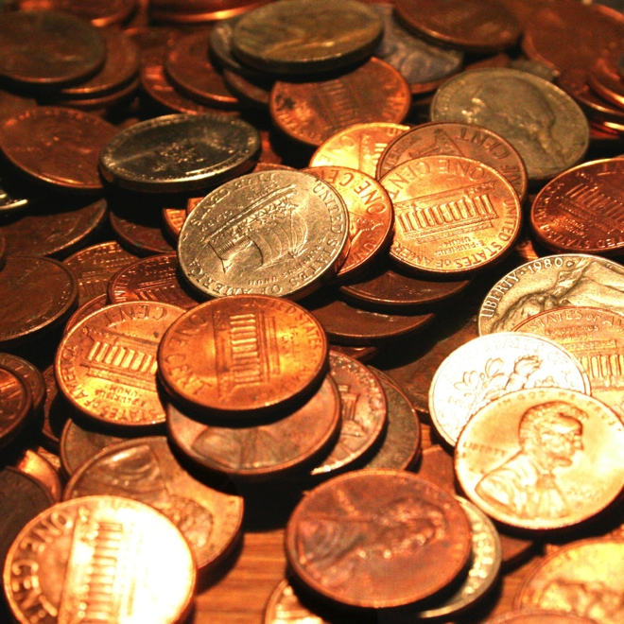
Existing Technical Debt
Things you could fix now but will do later at a higher cost.
Business pressure to release quickly
Lack of building loosely coupled components
Delayed refactoring
Lack of documentation
http://www.freeimages.com/photo/884054

Slide 6
Existing Technical Debt
Accept decisions made in the past
Address issues when they arise
Refactoring
Slow path to reducing
Make new decisions to not create more debt
Write more loosely coupled code
http://www.freeimages.com/photo/884054

Slide 7
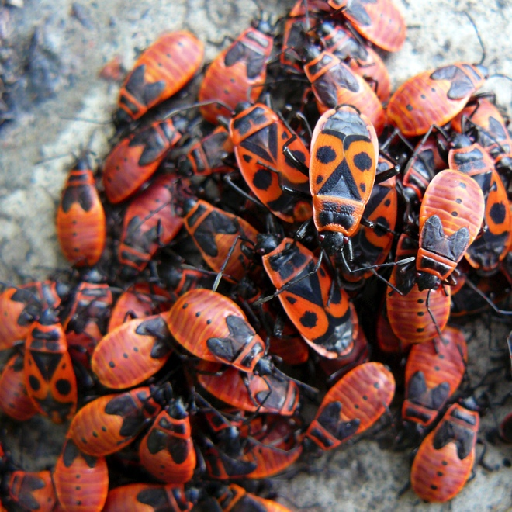
New Bugs
Complicated code
Small change in one section can affect another section
Challenging to catch
Until it is too late
Peer Code Reviews
http://www.freeimages.com/photo/1182513

Slide 8
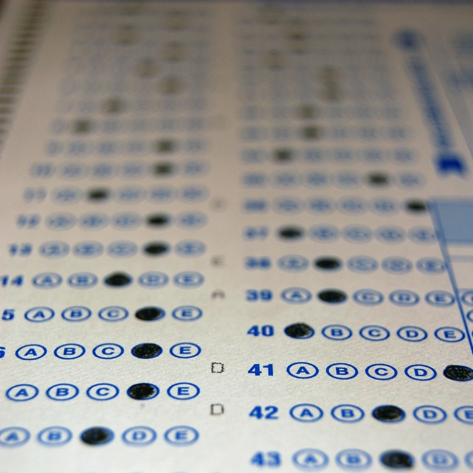
Manual QA Testing
Per ticket
Did it meet the spec?
Did it break anything else?
Going through each of the site verticals
Blog section, search pages, etc.
Challenges
Repetitious
Time Consuming
Inconsistent
http://www.freeimages.com/photo/517386

Slide 9
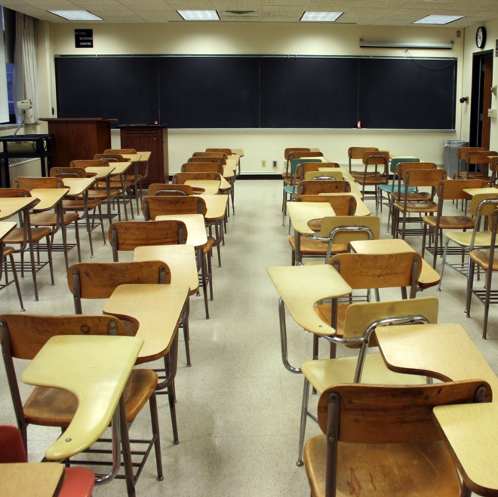
Concurrent Continuing Education
1-day course: “Agile & Scrum Fundamentals”
User Stories
Atlassian Webinar: “Do Agile Right”
User Personas
User Journeys
DrupalNights: “Behat – Human Readable Automated Testing”
Behat
http://www.freeimages.com/photo/1193228

Slide 10
Light Bulb Moment
Culture of Quality
Code Reviews
QA Testing
New Goals
Varied Users/Roles/Permissions
Focus on Business Value
Consistent Test Coverage
Easily Repeatable Tests
http://www.freeimages.com/photo/472591

Slide 11
Light Bulb Moment
Solution
User Personas
Varied users/roles/permissions
User Journeys
Focus on business value
User Stories
Noting individual tasks provide consistent feature coverage
Automated Acceptance Testing
Easily repeatable tests
http://www.freeimages.com/photo/472591

Slide 12
User Personas
Fictitious characters that represent each different type of person that visits your site.
Define your segments
Donors, volunteers, email subscribers, inactive members, paid members
Define your demographics
Age, sex, income, level of education, have children
Articulate their values & beliefs
Hobbies, political persuasion, goals, personality characteristics
Get under their skin
Self-image, day-to-day worries, habits
http://www.freeimages.com/photo/1338872

Slide 13
User Personas
Define the value they get from your organization
Why do they share posts, leave comments, donate money?
What roles/permissions do they have?
Admin, super-user, paid member, free member
What tasks do they commonly complete?
Uploading photos, rating content
Give them a face and a name
The process of discussing how these personas will feel, think and behave will give you information that you'd never be able to get if you used only your subjectivity.
http://www.freeimages.com/photo/1338872

Slide 14
User Personas

Slide 15
User Personas

Slide 16
User Personas

Slide 17
User Personas
Character Intelligent, enthusiastic, bold, persevering, achiever, not afraid of technology.
Role in BioRAFT Rodger manages the Earth EH&S Department and oversees all compliance activity via BioRAFT. He manages teams of auditors, conducts audits himself, and attends to a variety of compliance duties as necessary. Most of the time he delegates work to people on his team.

Slide 18
User Personas
Tasks in BioRAFT
View Dashboards
View Inspection Logs
Schedule Inspections
Monitor Bio & Chem & Rad Registrations
Oversees Lifesafety

Slide 19
User Personas
Common Access/Job Activities
Edit Basic Group Information￼
Edit Group Biological Information￼
Edit Group Chemical Information￼
Edit Group Equipment Inventory￼
Compliance Officer
EHS
View Institution Biological Information
Manage and Approve Biological Registrations
View Institution Chemical Information
Manage and Approve Chemical Registrations
Manage Radiological Licenses and Inventory
Manage Radiological Waste Collection

Slide 20
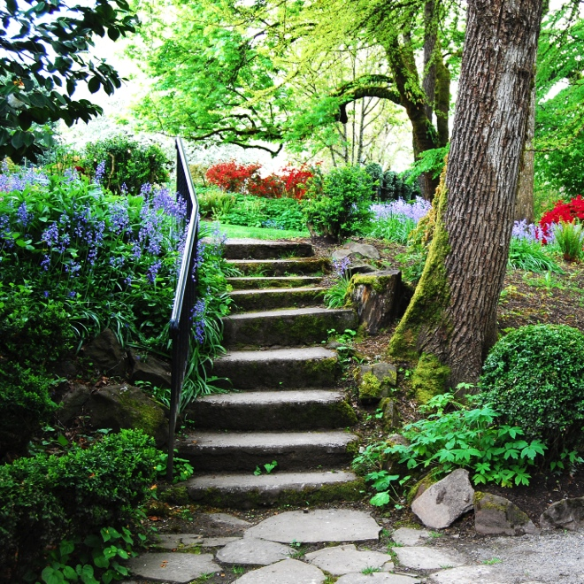
User Journeys
Displays user flow to prioritize feature enhancements.
Starts with a Persona and a goal on the website
Plots all actions to complete goal
Mark whether task is easy or hard
Highlight pain points
http://www.freeimages.com/photo/1005079

Slide 21
User Journeys

Slide 22
User Journeys

Slide 23
User Stories
Description of a feature from the perspective of the person who will be using it.
The value comes form putting the user’s experience first.
Helps you understand “why” you are building a certain feature.
As {type of user}, I want {some goal} So that {some reason}.
http://www.freeimages.com/photo/1068821

Slide 24
User Stories
As a member, I want to upload photos, So that I can share photos with others.
As an administrator, I want to approve photos before they are posted, So that I can make sure they are appropriate.
As {type of user}, I want {some goal} So that {some reason}.
http://www.freeimages.com/photo/1068821

Slide 25
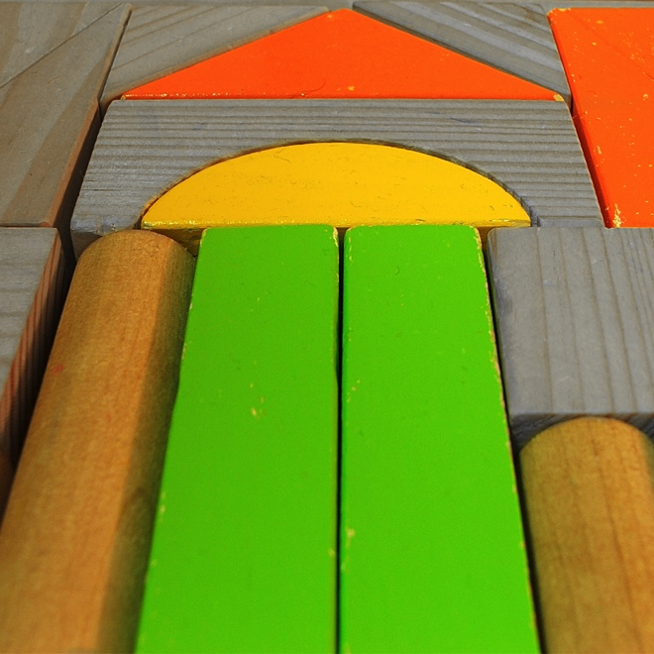
Behavior Driven Development (BDD)
Specialized version of test-driven development which focuses on behavioral specification of software units.
define a test set for the unit first
implement the unit
verify that the implementation of the unit makes the tests succeed
Excerpted from wikipedia.org
http://www.freeimages.com/photo/585286

Slide 26
Behavior Driven Development (BDD)
BDD specifies that business analysts and developers should collaborate in this area and should specify behavior (aka tests) in terms of user stories.
Direct correlation between the User Story a project manger writes and and a BDD Test that a developer writes.
http://www.freeimages.com/photo/585286

Slide 27
Behavior Driven Development (BDD)
User Story
As {type of user}, I want {some goal} So that {some reason}.
As a member,
I want to upload photos,
So that I can share photos with others.
http://www.freeimages.com/photo/585286

Slide 28
Behavior Driven Development (BDD)
BDD Scenario
Given {initial context}, When {event occurs}, Then {some outcome}.
Given I am logged in as a member,
When I am on my profile page,
I should see a link to upload photos.
http://www.freeimages.com/photo/585286

Slide 29
Behavior Driven Development (BDD)
A file for each Feature
search.feature
photos.feature
blog.feature
http://www.freeimages.com/photo/585286

Slide 30
Behavior Driven Development (BDD)
List Scenarios
Tag Scenarios
Run only which scenarios you want.
http://www.freeimages.com/photo/585286

Slide 31
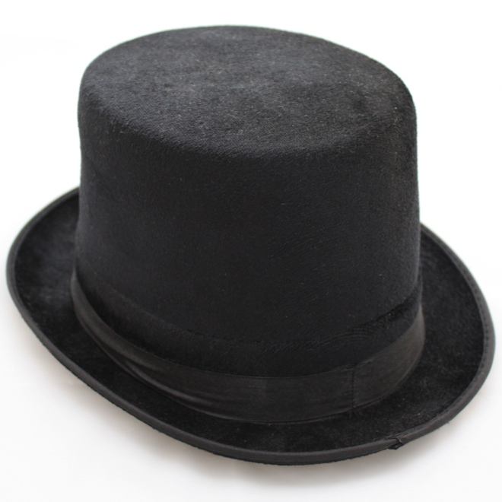
Behat
“Behat is a tool that makes behavior driven development (BDD) possible.
With BDD, you write human-readable stories that describe the behavior of your application.
These stories can then be auto-tested against your application. And yes, it’s as cool as it sounds!
Excerpted from docs.behat.org
http://www.freeimages.com/photo/1395333

Slide 32
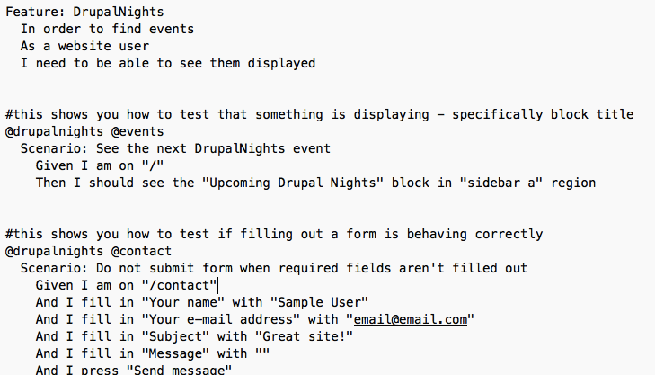
Behat - xxx.feature

Slide 33
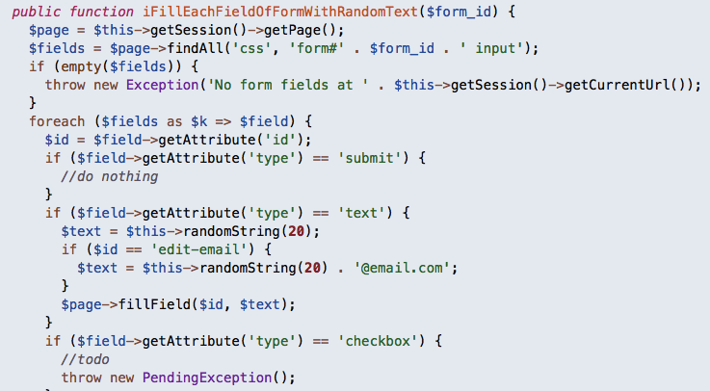
Behat – FeatureContext.php

Slide 34
Behat – Running Tests

Slide 35
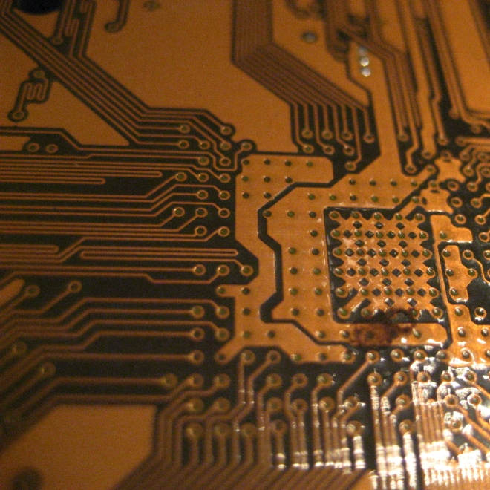
Code Coverage
What has the most Business Value?
Which Features, if taken away, would make your site essentially useless?
Examples:
Registering
Logging in
Customizing your profile
Writing posts
Leaving comments
Uploading photos
Approving photos
Seeing most recent articles
Rating content
Searching content
http://www.freeimages.com/photo/774486

Slide 36
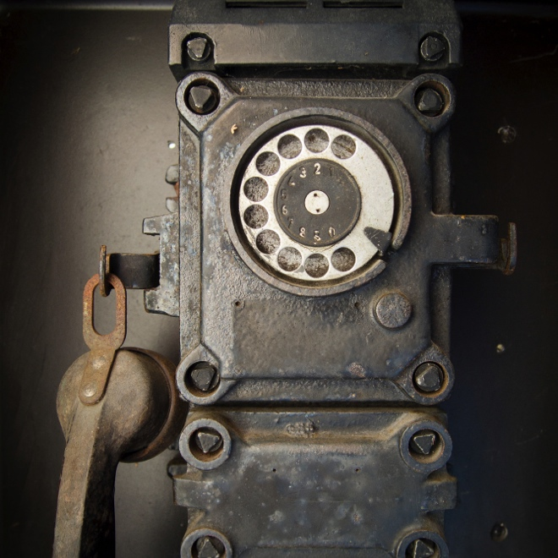
Take-Aways
Users are the most important part of a website. Put them first. Understand their needs.
Create Personas
Outline their Journeys
Define their Stories
Automate Acceptance Tests
Using Agile Practices and Behavior Driven Development encourages communication between product experts and developers.
http://www.freeimages.com/photo/1422832

Slide 37
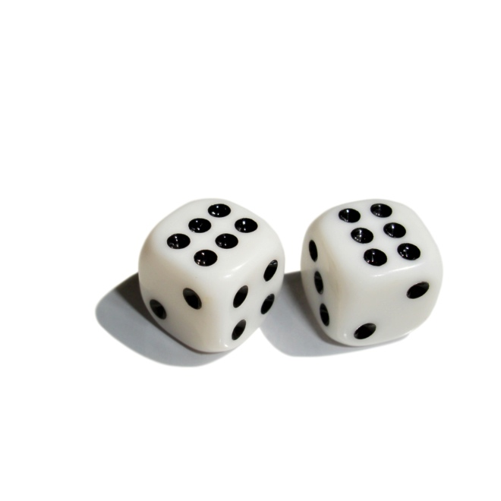
Bonus
If you migrate your site to another version of Drupal or even another platform, your Behat Scenarios will still be correct.
http://www.freeimages.com/photo/642737

Slide 38
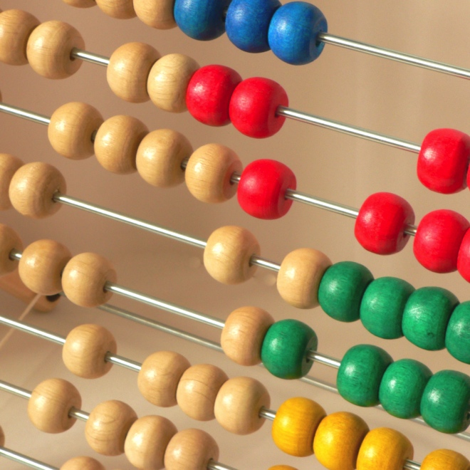
Recap
Problem
Existing Technical Debt
New Bugs
Time for Manual QA Testing
Solution
User Personas
User Journeys
User Stories
Automated Acceptance Testing
http://www.freeimages.com/photo/531969

Slide 39
Resources
Slides will be uploaded to DrupalNights.org!
User Personas blogs.atlassian.com & huffingtonpost.com
User Journeys blogs.atlassian.com & theuxreview.co.uk
User Stories mountaingoatsoftware.com searchsoftwarequality.techtarget.com
BDD wikipedia.org & dannorth.net codemag.com
Behat drupalnights.org & docs.behat.org github.com metaltoad.com & metaltoad.com drupal.org & drupal.org & drupal.org drupal.org & drupal.org & groups.drupal.org drupalwatchdog.com & bdd.alexo.it
Michelle Lauer
miche on D.O.
twitter.com/bymiche
bioraft.com
drupalnights.org
DGD7
http://www.freeimages.com/photo/985125

