Slide 1
Choosing a Graphing Library for the Modern Web
Questions to Ask as a Non-Developer
Heather Bauer
NEDCamp
Saturday, October 1st, 2016 – 4:15

Slide 2
About Me: Heather Bauer
Introduction
UX Product Specialist at BioRAFT
M.S. in Human Factors in Information Design at Bentley University
Co-Organizer of Boston Service Jam 2014
Expert in Residence for GA UXD course summer 2014
drupal.org/u/hezzieb
twitter.com/hezzieb524
linkedin.com/in/heathersbauer

Slide 3
About BioRAFT
Introduction
Enterprise safety, compliance & training software for lab scientists and those that work with them built with Drupal
SaaS, multi-site application.
WE’RE HIRING!
BioRAFT.com
DrupalNights.org
Notes:
Enterprise safety, compliance & training software for lab scientists and those that work with them built with Drupal

Slide 4
About You
Introduction
Usability Professionals
Project Managers
Developers
Other

Slide 5
Agenda
Introduction
Introduction
The problem
Questions to ask
Popular options
Our final winner
Q & A

Slide 6
The Problem

Slide 7
The Death of Flash
The Problem
Notes:
Photo: http://www.bluegrassdigital.com/media/100737/death-of-adobe-flash.jpg

Slide 8
The Death of Flash
The Problem
Hated for slowing down computers
Security concerns
Not supported on mobile devices
Chrome will block Flash from auto loading by the end of 2016 (10 exceptions)
Mozilla is beginning to phase the player out
Even Adobe is moving to HTML5
Notes:
http://www.businessinsider.com/adobe-flash-is-dying-a-death-by-1000-cuts-and-thats-a-good-thing-2015-8
http://digiday.com/platforms/google-chrome-block-adobe-flash/
https://www.cnet.com/news/google-to-block-flash-on-chrome-only-10-websites-exempt/
http://www.bbc.com/news/technology-36301904
http://fortune.com/2016/07/21/mozilla-google-facebook-phasing-adobe-flash/
http://www.huffingtonpost.com/entry/adobe-phasing-out-flash_us_565de8cde4b072e9d1c37767

Slide 9
What’s Replacing Flash?
The Problem
Notes:
Photo: https://www.w3.org/html/logo/downloads/HTML5_Logo_512.png

Slide 10
What’s Replacing Flash?
The Problem
58% faster
Can run on any computer or mobile device
Touch screen compatible
Doesn’t require a plug-in or player installation
Notes:
http://www.howtogeek.com/179213/why-browser-plug-ins-are-going-away-and-whats-replacing-them/
https://www.emaze.com/blog/your-first-emazing-experience/

Slide 11
Questions to Ask

Slide 12
Our Considerations
Questions to Ask
Does the data leave our servers?
Can it be used on all of our supported browsers?
What charts are available?
Will it work on mobile devices?
What are the accessibility concerns?
What is your budget?

Slide 13
Does the data leave our servers?
Questions to Ask
Could be important for data policies
It was important to us that we did not have send our data out to be processed
Notes:
Photo: http://sr.photos2.fotosearch.com/bthumb/CSP/CSP992/k13261660.jpg

Slide 14
Which browsers are supported?
Questions to Ask
Do you have commitments to support specific browsers?
What legacy browsers are you still supporting?
Notes:
Photo: http://outdatedbrowser.com/public/imgs/browsers-bg.png

Slide 15
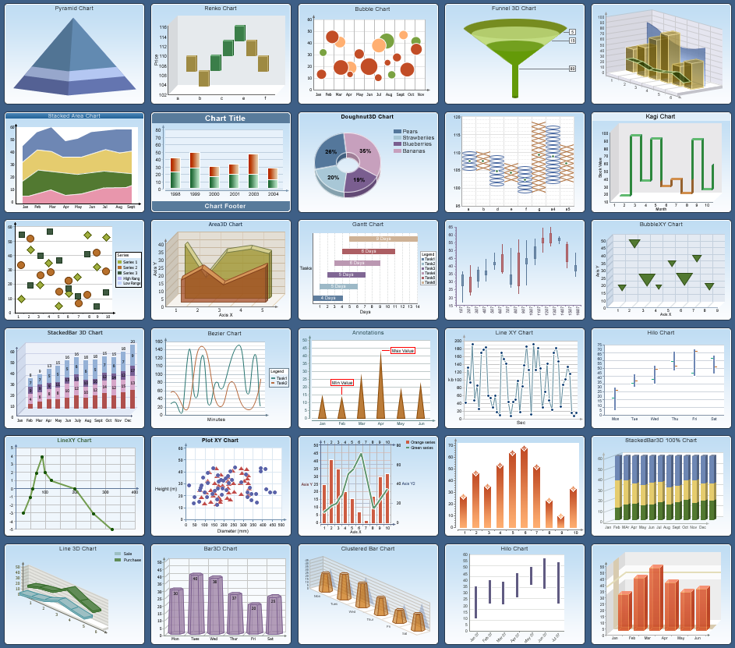
What charts are available?
Questions to Ask
Is there a particular chart type you need?
Can you create custom chart types?
Do you have resources to create chart types?
Notes:
Photo: http://helpcentral.componentone.com/NetHelp/ActiveReports6/images/charts_new.png

Slide 16
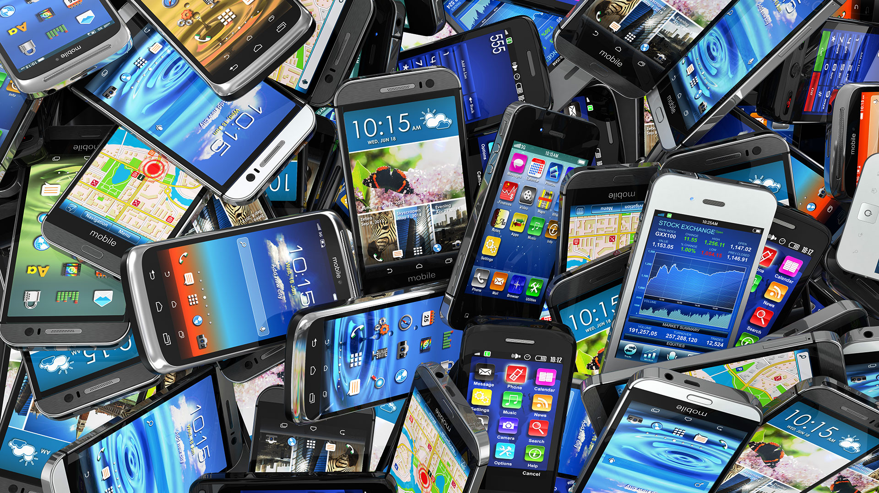
Will it work on mobile devices?
Questions to Ask
Is mobile functionality necessary?
This is related to the browser conversation
Notes:
Photo: http://marketingland.com/wp-content/ml-loads/2014/12/mobile-smartphones-pile-ss-1920.jpg

Slide 17
What are the accessibility concerns?
Questions to Ask
Issues for low vision and colorblind
Provide text alternative that provides the same data (WCAG 2.0 Guideline 1.1.1)
Readable in black and white – textures and patterns (WCAG 2.0 Guideline 1.4.1)
Notes:
http://accessibility.psu.edu/images/charts/
http://www.accessiq.org/news/news/2015/02/accessible-charts-and-information-graphics
https://www.paciellogroup.com/blog/2013/12/using-aria-enhance-svg-accessibility/
https://www.webaccessibility.com/best_practices.php?technology_platform_id=120
http://alistapart.com/article/accessibledatavisualization
Photo: http://tsubaki.ca/images/uploads/w3c-wcag.png

Slide 18
What is your budget?
Questions to Ask
There’s a large variety of price points
Notes:
Photo: http://images.clipartpanda.com/green-dollar-sign-clipart-consulting-clipart-green-dollar-signwhat-is-your-time-worth----rogue-river-consulting-blog-sp0s3dup.jpg

Slide 19
What other features are included?
Questions to Ask
Weigh the additional feature sets
Notes:
Photo: https://media.licdn.com/mpr/mpr/shrinknp_800_800/AAEAAQAAAAAAAAfMAAAAJDE0YWMzYjY2LTZiZmItNDMxMS1hZjhkLTZkOWViYjE0NzMwZA.jpg

Slide 20
Popular Options

Slide 21
Popular Options
Popular Options
Google Charts https://developers.google.com/chart/
D3.js https://d3js.org/
Chart.js http://www.chartjs.org/
FusionCharts http://www.fusioncharts.com/
Highcharts http://www.highcharts.com/
Zingchart https://www.zingchart.com/
And many more!
Notes:
goo

Slide 22
Our Final Winner

Slide 23
Final Winner
Final Winner
Notes:
goo

Slide 24
Questions?

Slide 25
Photo Credits
http://www.bluegrassdigital.com/media/100737/death-of-adobe-flash.jpg
https://www.w3.org/html/logo/downloads/HTML5_Logo_512.png
http://sr.photos2.fotosearch.com/bthumb/CSP/CSP992/k13261660.jpg
http://outdatedbrowser.com/public/imgs/browsers-bg.png
http://helpcentral.componentone.com/NetHelp/ActiveReports6/images/charts_new.png
http://marketingland.com/wp-content/ml-loads/2014/12/mobile-smartphones-pile-ss-1920.jpg
http://tsubaki.ca/images/uploads/w3c-wcag.png
http://images.clipartpanda.com/green-dollar-sign-clipart-consulting-clipart-green-dollar-signwhat-is-your-time-worth----rogue-river-consulting-blog-sp0s3dup.jpg
https://media.licdn.com/mpr/mpr/shrinknp_800_800/AAEAAQAAAAAAAAfMAAAAJDE0YWMzYjY2LTZiZmItNDMxMS1hZjhkLTZkOWViYjE0NzMwZA.jpg

Slide 26
Resources
http://www.businessinsider.com/adobe-flash-is-dying-a-death-by-1000-cuts-and-thats-a-good-thing-2015-8
http://digiday.com/platforms/google-chrome-block-adobe-flash/
https://www.cnet.com/news/google-to-block-flash-on-chrome-only-10-websites-exempt/
http://www.bbc.com/news/technology-36301904
http://fortune.com/2016/07/21/mozilla-google-facebook-phasing-adobe-flash/
http://www.huffingtonpost.com/entry/adobe-phasing-out-flash_us_565de8cde4b072e9d1c37767
http://www.howtogeek.com/179213/why-browser-plug-ins-are-going-away-and-whats-replacing-them/
https://www.emaze.com/blog/your-first-emazing-experience/
http://accessibility.psu.edu/images/charts/
http://www.accessiq.org/news/news/2015/02/accessible-charts-and-information-graphics
https://www.paciellogroup.com/blog/2013/12/using-aria-enhance-svg-accessibility/
https://www.webaccessibility.com/best_practices.php?technology_platform_id=120
http://alistapart.com/article/accessibledatavisualization

Slide 27
Choosing a Graphing Library for the Modern Web
Slides will be available on drupalnights.org/library
twitter.com/hezzieb524
linkedin.com/in/heathersbauer
Heather Bauer
NEDCamp
Saturday, October 1st, 2016 – 4:15

