Slide 1
One Year Anniversary Event
Ask The Experts
drupalnights.org
July 17, 2014

Slide 2
Why Drupal Nights?
Foster an open conversation between developers.
Share & learn best practices, strategies, and code.
Create strong community ties.
drupalnights.org

Slide 3
Why Drupal Nights?
Demonstrate that BioRAFT is a great place to work.
Yes, we are hiring!
drupalnights.org

Slide 4
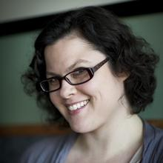
Dani Nordin
User Research for the Web and Applications
July 2013
drupalnights.org

Slide 5
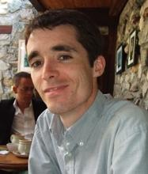
Stéphane Corlosquet
Keeping Your Site Secure
August 2013
drupalnights.org

Slide 6
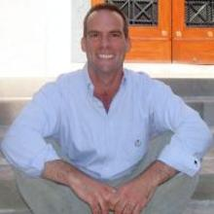
Ed Carlevale
Blending Drupal Distributions for Custom Websites
September 2013
drupalnights.org

Slide 7
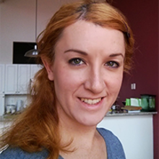
Jesse Beach
The Semantic Application Layer and Accessibility
October 2013
drupalnights.org

Slide 8
Jason Pamental
Think Responsively, Design Responsibly
November 2013
drupalnights.org

Slide 9
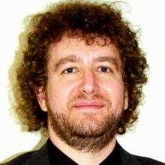
Seth Cohn
Behat: Human-Readable Automated Testing
December 2013
drupalnights.org

Slide 10
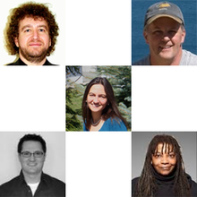
Panel
High Performance Drupal
January 2014
drupalnights.org

Slide 11
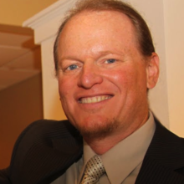
Kay VanValkenburgh
Client Training Rollouts Using Personas
February 2014
drupalnights.org

Slide 12
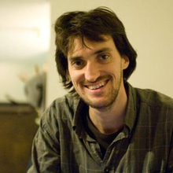
Ben Melançon
Powering your API with Drupal 8
March 2014
drupalnights.org

Slide 13
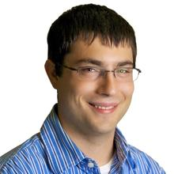
Nic Laflin
Using Drupal as a Platform
April 2014
drupalnights.org

Slide 14
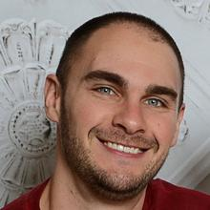
Chris Pliakas
Accelerate Drupal Development By Getting Off The Island
May 2014
drupalnights.org

Slide 15
Micky Metts
VoipDrupal - Your Site and a Regular Phone
June 2014
drupalnights.org

Slide 16
Panel
Ask The Experts
July 2014
drupalnights.org

Slide 17
One Year Anniversary Event
Ask The Experts
drupalnights.org
July 17, 2014

