Slide 1
Drupal Commerce 2.x
Checking in on Checkout
Notes:
Part 1 - Intro

Slide 2
What’s the point of this presentation?
Drupal Commerce 2.x
is available.
Right now.
(Today is 8/17/2016)
Notes:
Part 1 - Intro

Slide 3
Is every slide going to lead with a question?
Maybe. I haven’t finished making them all at this point.
We will ask these questions, and then try to answer them:
What’s different about Commerce 2?
How ready is it right now?
When should I be planning to use it for Drupal 8 projects?
Notes:
Part 1 - Intro

Slide 4
Who *is* this guy?
Kevin Baringer Bio:
Developing software since 1995 in one technology stack or another, Kevin has been splashing around in Drupal since 2009 and currently runs a one-nerd-shop offering Drupal development, consultation, architecture and training. Tapping into the wealth of information, inspiration and ingenuity that is so abundant in the Drupal community is his favorite part of this work and makes the hours of key-banging and head-scratching all worthwhile. In the rare moments when Kevin isn't code-monkeying around he likes to spend his time outdoors; hiking, kayaking, camping and sometimes falling down. Otherwise his off-hours are spent in community theater in Portsmouth, NH, practicing guitar or ukulele and seriously playing silly games with extremely silly people.
Notes:
Part 1 - Intro

Slide 5
So he’s a big-time E-Commerce Expert, right?
Nope.
Notes:
Part 1 - Intro

Slide 6
Then why would he be presenting on Drupal Commerce 2?
Because, as a Drupal Developer he needs to know this stuff, and there’s no better motivation to learn something than to be on the hook to present about it.
Also, he’s done Drupal training and is getting his feet fairly damp with Drupal 8 at the moment, so it’s not like he’s a total ignoramus.
*total* being the operative word.
Also, there are lots of links to authoritative sources in this presentation, so stick around.
Notes:
Part 1 - Intro

Slide 7
Still here?
Good.
Let’s do this.
Notes:
Part 1 - Intro

Slide 8
Definition of E-Commerce
Seriously?
Buying stuff online?
Dictionary.com says: “business that is transacted by transferring data electronically, especially over the Internet.”
Note… not exclusively over the internet.
Takeaway: It’s about doing business. The key to doing business is “don’t make me do stuff that’s not related to my business”.
I.E. “Don’t make me wrestle with my commerce platform. I’ve got inventory to order, schedules to plan and widgets to make.”
Conclusion:
UX (User Experience) will determine the success of a commerce platform.
Notes:
Part 2 - Background

Slide 9
Who Makes Drupal Commerce?
The Commerce Guys: https://commerceguys.com/
Smaller, leaner company now after choosing to split-off from Platform.sh
Notes:
Part 2 - Background

Slide 10
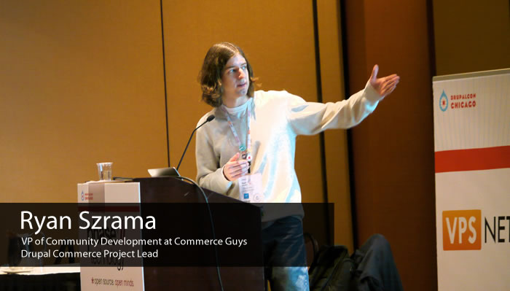
Commerce Guy: Ryan Szrama
President / CEO at Commerce Guys
https://commerceguys.com/user/12

Slide 11
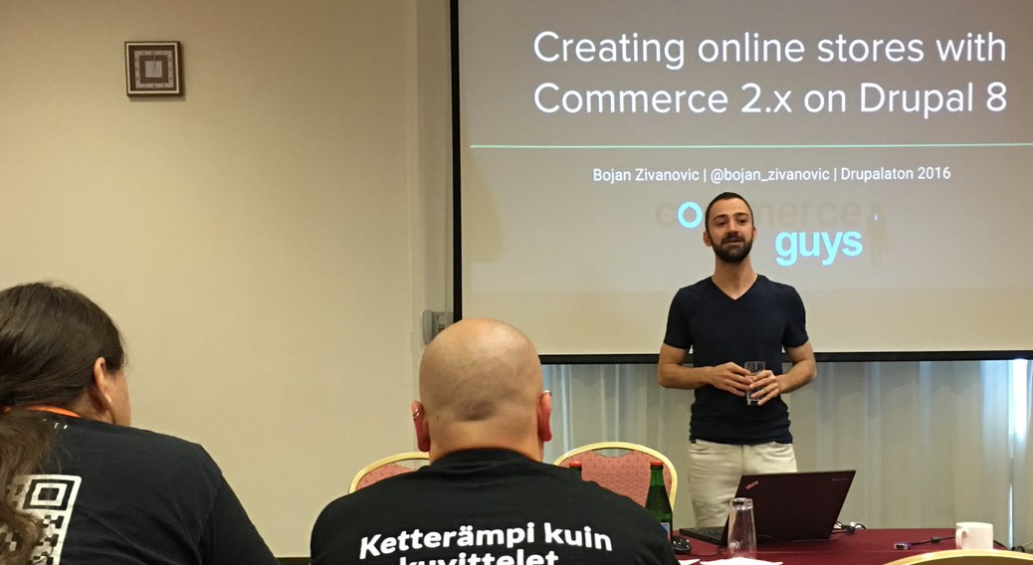
Commerce Guy: Bojan Živanović
Lead Developer at Commerce Guys
https://commerceguys.com/user/21

Slide 12
Commerce Guy: Matt Glaman
Senior Drupal Consultant at Commerce Guys
https://commerceguys.com/user/8469

Slide 13
Commerce Guy: Doug Cone
Senior Drupal Developer at Commerce Guys
https://commerceguys.com/user/8931

Slide 14
Challenges for Commerce 1.x (1)
Notes from the DrupalCon New Orleans 2016 presentation by Commerce Guys:
1.x Required everyone to be an Ecommerce expert
Not easily usable, didn't help you make decisions
Users didn't have time to learn everything so they went with other solutions with more support.
Some contrib modules weren’t written with scalability in mind.
Notes:
Part 2 - Background

Slide 15
Challenges for Commerce 1.x (2)
They couldn't control Commerce namespace being used by other parties, so quality was highly variable.
Need to work with contrib module devs to conform to standards (coding and otherwise)
Commerce was designed to have a better data model than Ubercart, but that didn't necessarily translate to a better experience.
Did not prioritize UX enough – too many clicks to add Product

Slide 16
Challenges for Commerce 1.x (3)
Here’s a great podcast interview with Bojan covering the lessons learned from 1.x and how they translated to improvements in 2.x:
https://modulesunraveled.com/podcast/154-commerce-2x-drupal-8-bojan-zivanovic-modules-unraveled-podcast

Slide 17
Commerce 2: Gotta Find My Purpose
New Approach to providing solutions for selling online
Usability Vs. Flexibility:
Less focused on flexibility, more focused on usability
Solve more problems rather than provide unlimited flexibility
"Collectively engineering solutions to the hardest parts of selling online." - Ryan Szrama – DrupalCon 2016, New Orleans
Notes:
Part 3 – New Approach

Slide 18
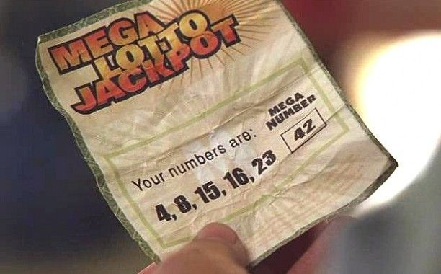
Getting Off The Island
Notes:
Part 3 – New Approach

Slide 19
How Do We Get Off The Island? (1)
Symfony …
Leverages a larger, existing community of contributors who can now help make Drupal 8 and Commerce 2 better.
Offers Plug-Ins contributed by that larger community
Provides a flexible, performant platform that attracts new contributors.
Notes:
Part 3 – New Approach

Slide 20
How Do We Get Off The Island? (2)
Object Oriented PHP And Namespaces …
Encapsulation
Make it easier to use external libraries & plugins
Improved encapsulation of code
Notes:
Part 3 – New Approach

Slide 21
How Do We Get Off The Island? (3)
Composer …
Provides Dependency management
Allows for dependencies outside of Drupal modules
Autoload.php includes classes dynamically rather than requiring developers to do it manually.
Composer makes it easier to get off the ground
Read More: https://bojanz.wordpress.com/2015/09/18/d8-composer-definitive-intro/
Notes:
Part 3 – New Approach

Slide 22
How Do We Get Off The Island? (4)
Third party collaboration …
CommerceGuys partnered with Acromedia to deliver solutions
Making Android better (whuh?)
Bojan contributed code back to Google’s Address data set as part of the work for creating the ‘addressing’ and ‘zone’ PHP libraries.
Making friends
Notes:
Part 3 – New Approach

Slide 23
How Do We Get Off The Island? (4)
Sharing the new PHP Libraries that Commerce 2 introduced (and requires) with the world and getting feedback and improvements in return.
addressing – https://github.com/commerceguys/addressing
PHP 5.4+ addressing library, powered by Google's dataset
intl – https://github.com/commerceguys/intl
PHP 5.4+ internationalization library, powered by CLDR data -- parts being adopted by Symfony
zone – https://github.com/commerceguys/zone
PHP 5.4+ zone management library
tax – https://github.com/commerceguys/tax
PHP 5.4+ tax library - being adopted by Foxycart
Notes:
Part 3 – New Approach

Slide 24
How Do We Get Off The Island? (5)
In Summary…
Symfony makes Drupal 8 and Commerce 2 part of a larger world.
Object Oriented standards such as Namespacing make it easier to extend and incorporate third party code into the application.
Composer makes it easier to manage the complex relationships and dependencies of the numerous components involved as well as automatically handling class includes.
Third party collaboration with partners and helping to improve code that we use makes us better citizens.
Contributing new PHP Libraries that solve essential challenges for e-commerce and can be used by anyone, even competitors.
Notes:
Part 3 – New Approach

Slide 25
And Now… A Note about Drupal Console (1)
The Commerce 2 installation instructions recommend using Drupal Console: http://docs.drupalcommerce.org/v2/install.html
There is debate as to whether or not Drupal Console is eventually meant to replace Drush: http://drupal.stackexchange.com/questions/202075/is-drupal-console-aimed-to-replace-drush
Some people really love it: http://www.pixelite.co.nz/article/10-things-i-learnt-building-in-drupal-8/
But the current situation seems to call for using both Drush and Drupal Console: https://pantheon.io/blog/drush-and-drupal-console-drupal-8
Notes:
Part 3 – New Approach

Slide 26
And Now… A Note about Drupal Console (2)
What is this Drupal Console thing anyway?
“The Drupal Console is a suite of tools run from a command line interface (CLI) to generate boilerplate code and interact with a Drupal 8 installation. From the ground up, it has been built to utilize the same modern PHP practices which were introduced in Drupal 8.
The Drupal Console makes use of the Symfony Console and other third party components which allows you to automatically generate most of the code needed for a Drupal 8 module. In addition, Drupal Console helps you interact with your Drupal installation.”
Drupal Console documentation: https://hechoendrupal.gitbooks.io/drupal-console/content/en/index.html
Notes:
Part 3 – New Approach

Slide 27
But That’s A Different Story
Notes:
Part 3 – New Approach

Slide 28
Commerce 2 Latest Build
As of today (8/17/2016), the latest recommended build for Commerce 2 is:
8.x-2.0-alpha4
Alpha’s do not have an upgrade path yet
Still missing some functionality
Not recommended for live sites
Let’s take a look anyway, shall we?
Read More: https://www.drupal.org/project/commerce

Slide 29
What’s In the Box? (1)
Commerce 2 is being re-written from the ground up
Many features that used to be contrib are now in Commerce core
Lots of work has been done on the suite of required modules for Commerce 2 (by CommerceGuys and partners)
Features we’ll talk about:
Taxes
Store Entity
Products
Product Attributes
Order & Line-Item Content Types
Order Editing Wizard
Add to Cart Form
Shopping Cart
Checkout Workflow
Payment
Notes:
Part 4 - Features

Slide 30
What’s In the Box? (2)
Also
this…
Sorry.
Notes:
Part 4 - Features

Slide 31
REQUIRED MODULES
Drupal Commerce 2 requires 5 modules:
Entity API
Inline Entity Form
Address
State Machine
Profile
These have either been created by or are contributed to by CommerceGuys.

Slide 32
Required Modules (1)
Entity API - https://drupal.org/project/entity
Extends Drupal 8's entity API with additional features.
Most D7 Entity API improvements were added to Drupal 8 core.
The Drupal 8 version of the Entity API module is used for improvements to Drupal 8's Entity functionality which will in turn be moved to Drupal core one day (development ongoing).

Slide 33
Required Modules (2)
Inline Entity Form – https://drupal.org/project/inline_entity_form
Provides a widget for inline management (creation, modification, removal) of referenced entities.
Example Inline Entity Relationships in Commerce 2:
Products -> Variations
Orders -> Line-Items
Currently being used in the wild for D8 with a few remaining bugs
Sponsored by the Acquia module acceleration program
Lots of fixes/enhancements made earlier in 2016
More popular than Commerce itself (built by Commerce Guys)
Read More: https://drupalcommerce.org/blog/44305/commerce-20-alpha4-released

Slide 34
Required Modules (3)
Address - https://drupal.org/project/address
Storing, validating and displaying international postal addresses
Drupal 8 heir to addressfield module
Powered by the CommerceGuys 'addressing' and 'zone' PHP libraries
Uses Google Android data set
CommerceGuys contributed enhancements back to the Google Android data set (so they're also Android contributors now too)
Provides translated and cached data for countries and all varying levels of sub-divisions (state, province, county, etc.)
Address Zones (territorial groupings for shipping or tax purposes)

Slide 35
Required Modules (4)
State Machine - https://drupal.org/project/state_machine
Provides Workflow with States and Transitions:
“A workflow is a set of states and transitions that an entity goes through during its lifecycle. A transition represents a one-way link between two states and has its own label.”
In D8 workflows are defined in YAML (similar to menu links)
Used in Commerce 2 for the Order workflow solution

Slide 36
Required Modules (5)
Profile - https://drupal.org/project/profile
Provides configurable User profiles
Separate entity from the User, but linked
Commerce adds billing & shipping profile types

Slide 37
COMMERCE 2 FEATURES

Slide 38
Currency Management (1)
Leverages the “intl” PHP library built by CommerceGuys (https://github.com/commerceguys/intl)
Provides access to data from the Unicode Common Locale Data Repository (CLDR) - used by Google, Microsoft, Apple & IBM among others. (http://cldr.unicode.org/)
Currency lists & translations in over 200 languages
Currency symbols & formatting displayed as they are used within the country local of user
Notes:
Part 4 - Features

Slide 39
Currency Management (2)
For Example…
Given the amount: 12345.99 EUR
France expects to see it as: 12 345,99 €.
Germany expects to see it as: 12.345,99 €.
The UK expects to see it as: €12,345.99.
Read More: https://drupalcommerce.org/blog/41828/commerce-2x-stories-currencies
And even more: https://drupalcommerce.org/blog/15916/commerce-2x-stories-internationalization
Notes:
Part 4 - Features

Slide 40
Taxes (1)
Commerce 2 is now completely separate from Rules module
Leverages the “tax” and “zone” PHP libraries provided by CommerceGuys (https://github.com/commerceguys/tax & https://github.com/commerceguys/zone).
Making tax calculation easier & more user-friendly
Notes:
Part 4 - Features

Slide 41
Taxes (2)
Smart data model designed for fluctuating tax rate amounts ("19% -> 21% on January 1st")
Predefined tax rates for EU countries and Switzerland.
More to come (Australia, South Africa, etc.)
Tax resolvers with logic for all major use cases (B2B, B2C, digital & physical products)
For the U.S. they recommend a Tax Cloud service to handle taxes by zip-code, states, etc. (Ex: Avalara)
Notes:
Part 4 - Features

Slide 42
Stores (1)
An order is now connected to a single Store Entity
A Store represents a billing location (helps with tax calculations)
Supports multiple stores in multiple countries
Products can be offered from multiple stores
Two Use-Cases…
Notes:
Part 4 - Features

Slide 43
Stores (2)
Use Case 1: Single Business
with Multiple Locations
The same product catalog is used for all stores.
Customers always belong to a single store, usually based on their billing address.
Example: Commerce Guys has a French office and a US office. These offices are separate legal entities. People who purchase Platform.sh are billed from one of the offices based on their location. EU customers are assigned to the French store, North American customers to the US store.
Notes:
Part 4 - Features

Slide 44
Stores (3)
Use Case 2: Marketplace model
Sellers can open accounts on the site, create and sell their own products.
The product catalog is store-specific. The site lists multiple stores, each with their own products.
Products are grouped into carts/orders per store.
Example: https://www.etsy.com/
Notes:
Part 4 - Features

Slide 45
Stores (4)
Adding Products Workflow:
Import a currency
Create a store
Create products
Steps 1 & 2 can be done quickly from the CLI using Drupal Console
Read More: https://drupalcommerce.org/blog/42419/commerce-2x-stories-stores
Notes:
Part 4 - Features

Slide 46
Products (1)
Redefined architecture
Product Entity is now the actual product display page (no more "product display" nodes)
Product Variations with SKUs, sizes, etc. have relationship to Product Entity (Similar to Commerce Kickstart implementation)
Read More: https://drupalcommerce.org/blog/42500/commerce-2x-stories-products
Notes:
Part 4 - Features

Slide 47
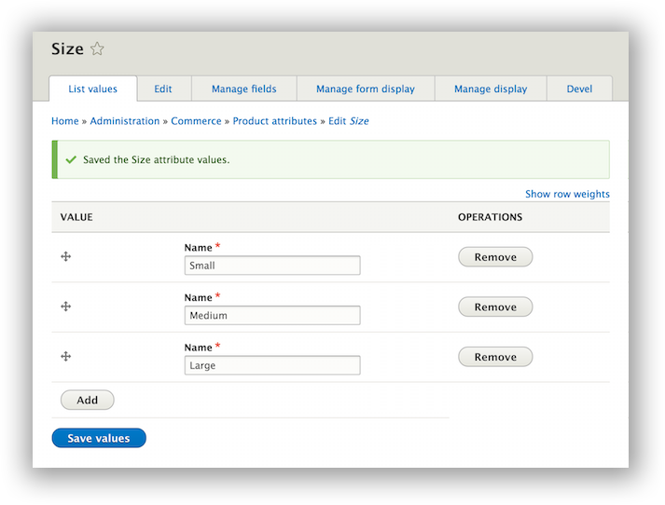
Product Attributes (1)
Product Attributes and Attribute Values are now Entity Types:
commerce_product_attribute
commerce_product_attribute_value
Allows for the creation of a more optimized UI, which allows creating and reordering multiple values at the same time.
Read More: https://drupalcommerce.org/blog/44305/commerce-20-alpha4-released
Notes:
Part 4 - Features

Slide 48
Product Attributes (2)
As a result:
No longer need to use Taxonomy to assign attributes to Product Variations
Prevent admins from deleting attribute terms that have already been purchased (breaking workflow)
New attributes are automatically available to Product Variations, no need to set up Term Reference, Vocab., etc.
Also…
Swatches (Fancy Attributes) available in cart now out-of-the-box (https://drupalcommerce.org/blog/44310/enabling-fancy-attributes-commerce-2x)
Notes:
Part 4 - Features

Slide 49
Order and Line Item Types
Added to Commerce 2 core, removing the need for 2 contrib modules:
commerce_order_types
commerce_custom_product
We can now have separate Order Types for different types of products (physical, digital, event registration, membership, etc.)
Different Order Types can have completely different workflows, logic and checkout experiences.
Line Item Types (for customizable products) are now provided by default in Commerce 2 core.
Notes:
Part 4 - Features

Slide 50
Order Editing
Added an Order Wizard for administrators to build a new Order form with guidance step-by-step.
Overall improved UX in Order editing in commerce core
Right columns provide the IP address and the geo location of the order.
Notes:
Part 4 - Features

Slide 51
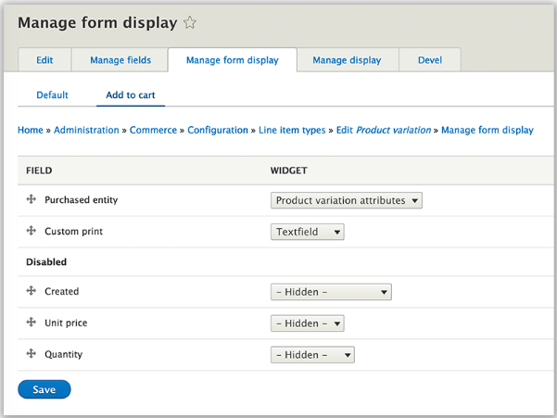
Add to Cart Forms
Add-To-Cart form builder is now based on the Line-Item type.
Thus, In addition to regular attributes (color, size), Line-Item fields are exposed in the same form (custom print text, image, etc.) using the Form Display mode.
In 1.x this required extra code.
Read more: https://drupalcommerce.org/blog/44226/commerce-20-alpha3-released
Notes:
Part 4 - Features

Slide 52
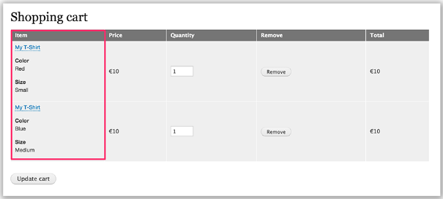
Multiple Shopping Carts
Shopping Carts: If you having multiple shopping carts, the UI will help to see and checkout each of them separately.
Notes:
Part 4 - Features

Slide 53
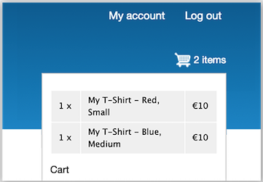
Shopping Cart Block
Easily customizable shopping cart block.
Displays Cart icon with number of items in cart
Clicking the icon displays a pop-up with more detailed info.
Read More: https://drupalcommerce.org/blog/44226/commerce-20-alpha3-released
Notes:
Part 4 - Features

Slide 54
Checkout Flows (1)
Checkout flows are plugins providing multi-step forms that can be configured by store administrators.
This configuration is stored in matching commerce_checkout_flow config entities.
Config Entities = YML Files
Read More: http://www.wunderkraut.com/blog/configuration-entities-in-drupal-8/2014-07-14
Each Order Type can have it’s own checkout flow.
Notes:
Part 4 - Features

Slide 55
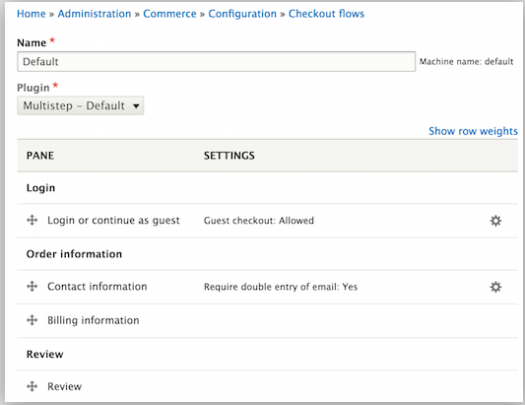
Checkout Flows (2)
Checkout Flows can be configured using the default checkout flow implementation, which uses Checkout Panes.
The checkout pane configuration UI is AJAX powered and resembles the "Manage display" field UI.
Developers can also add completely custom Checkout Flows by adding a new Checkout Flow plugin.
Read More: https://drupalcommerce.org/blog/44305/commerce-20-alpha4-released
Notes:
Part 4 - Features

Slide 56
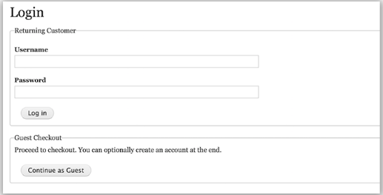
Improved Checkout UX (1)
Not quite there yet – still under development
Provides the option to do checkout as a guest user or register as a new user during checkout.
Notes:
Part 4 - Features

Slide 57
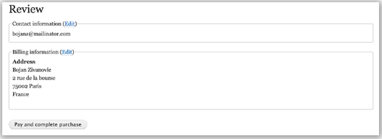
Improved Checkout UX (2)
Redesigned review pane (including edit links leading to the original step, better markup)
Contextual action buttons ("Continue to review", "Pay and complete purchase")
Upcoming work includes a checkout progress block, the cart summary, and reusing addresses.
Read more: https://drupalcommerce.org/blog/44305/commerce-20-alpha4-released
Notes:
Part 4 - Features

Slide 58
Payments
Still under active development on Github (sprinted at DrupalCon New Orleans)
Currently integrating Braintree and Authorize.Net as reference implementations.
Expanding the API to improve the DX (Development Experience)
Building tokenization by default into the core API
BREAKING NEWS! Initial Payment functionality was checked into 8.x-2.x-dev version on 8/16/2016: https://www.drupal.org/node/2711013#comment-11521173
Notes:
Part 4 - Features

Slide 59
Testing
Removed Commerce from the SimpleTest framework and switched to broader industry standard PHPUnit.
Based on the move of Drupal core to KernelTestBaseTNG™ (https://www.drupal.org/node/2304461)
“Drupal should not be in the business of developing a testing framework.”
Read More: https://drupalcommerce.org/blog/45322/commerce-2x-unit-kernel-and-functional-tests-oh-my

Slide 60
Take a Breath
This slide is mostly for me.

Slide 61
FEATURES SUMMARY (1)
Currency Management - Uses the new 'intl' PHP library to leverage CLDR data to pull lists, translations, symbols and formatting for global currencies
Taxes - Replaced Rules for tax handling with core code that leverages the 'tax' and 'zone' PHP libraries
Stores - Stores are now entities which represent billing locations for orders to connect to and provide multi-store or marketplace use-cases.

Slide 62
FEATURES SUMMARY (2)
Products - Re-architected to do away with "display nodes" Product entities are now displayable and Variations are built-into core.
Product Attributes - Attributes and Attribute Values are now entity types which allows for a more optimized UI. Also swatches in the cart.
Order & Line Item Types - Added to core, allowing for separate order types like physical, digital, memberships, etc. and different workflows for each, plus Line Item attributes like customer-input text or images for orders.
Order Editing - Adding an Order Wizard to help admins build the order form with guidance an an overall improved user experience

Slide 63
FEATURES SUMMARY (3)
Add to Cart Forms - Form builder based on the Line Item type to provide easier editing of the Add-to-Cart form that includes attributes and Line-Items
Multiple Shopping Carts - UI improvements in Checkout to handle multiple shopping carts
Shopping Cart Block - Now we have the standard cart icon and popup "view my cart" experience!

Slide 64
FEATURES SUMMARY (4)
Checkout Flows - The checkout experience is now easier to edit and highly customizable via configuration entities and plugins
Improved Checkout UX - Still in progress but will provide options for checkout as guest or signing-up and a redesigned order review pane
Payments - Still in progress but will include sample implementations of Braintree and Authorize.Net gateways and an expanded API to improve developer experience
Testing - Now using PHPUnit instead of SimpleTest, keeping in-line with Drupal core

Slide 65
Modules, Modules Everywhere…
… But not a whole lot for Commerce 2 yet.
There are tons of contrib modules in the Commerce 1.x ecosystem
http://contrib.drupalcommerce.org shows 741 modules that have a “commerce_” or “dc_” prefix (pulled from drupal.org using their API).
Most of these do not have Drupal 8/Commerce 2 releases in progress let alone ready to use.
Why? Drupal 8 is still new and Commerce 2 is even newer.
Good news: Lots of stuff that was contrib for Commerce 1.x will be in Core for Commerce 2. Better architected, better supported.

Slide 66
Okay… When? When? When?
The first Beta release is what will most likely be recommended as the first release for live production sites.
Beta Release Doc for tracking: https://www.drupal.org/node/2733869
Reasonable guess is fall 2016 or even early 2017
It’s going to be great! Eventually.
Woot!
https://www.youtube.com/watch?v=L09qnRfZY-k

Slide 67
What’s YOUR Experience With Commerce?
Also Q&A, but no guarantees that I have any answers.

Slide 68
Movin’ On Up
It’s going to be great! We’re gonna help people sell lots of stuff!
Celebrate a little. Do a dance.
Go on.
You know you want to.
Here’s this again:
https://www.youtube.com/watch?v=L09qnRfZY-k
Thanks for attending!!

Slide 69
Resources (1)
Pre-Drupal 8 Commerce
General e-commerce for Drupal Guide (Mostly pre-D8)
https://www.drupal.org/resource-guides/building-ecommerce
Drupal 8 Commerce Resources
Commerce Project
https://www.drupal.org/project/commerce
Commerce 2.x Installation Guide
http://docs.drupalcommerce.org/v2/install.html
The definitive introduction to D8 and Composer
https://bojanz.wordpress.com/2015/09/18/d8-composer-definitive-intro/
Launching Commerce on Drupal 8
https://drupalcommerce.org/blog/14871/launching-commerce-drupal-8
Drupal 8: overview of the Commerce 2.x module for online stores
http://internetdevels.com/blog/the-commerce-2x-module-for-Drupal-8

Slide 70
Resources (2)
Drupal 8 Commerce Resources (continued)
Drupal 8 Commerce is on the Way! DrupalCon New Orleans 2016. (May 27, 2016)
http://valuebound.com/resources/blog/drupal-8-commerce-on-way-drupalcon-new-orleans-2016
Creating online stores with Commerce 2.x on Drupal 8
https://events.drupal.org/neworleans2016/sessions/creating-stores-drupal-commerce-drupal-8
The Future of Commerce on Drupal 8 (and beyond)
https://latinamerica2015.drupal.org/session/future-commerce-drupal-8-and-beyond.html
Drupal 8: overview of the Commerce 2.x module for online stores
http://drupalsun.com/alrai/2016/08/09/drupal-8-overview-commerce-2x-module-online-stores
State of Drupal Commerce for Drupal 8
https://blog.liip.ch/archive/2016/04/21/state-drupal-commerce-drupal-8.html
Drupal 8 and the future of ecommerce (Dec. 02, 2015)
http://www.zyxware.com/articles/5308/drupal-8-and-the-future-of-ecommerce

Slide 71
Resources (3)
Drupal 8 Commerce Resources (continued)
Stock for Drupal 8 commerce - Technical overview & use cases (May 11, 2016)
https://www.blue-bag.com/blog/stock-drupal-8-commerce-technical-overview-use-cases
Meet Commerce 2.x (May, 13, 2015 at DrupalCon Los Angeles)
https://events.drupal.org/losangeles2015/sessions/meet-commerce-2x
Four Ways Drupal 8 Will Make Drupal Commerce The Best E-Commerce Platform Of All Time
https://www.wearegenuine.com/blog/four-ways-drupal-8-will-make-drupal-commerce-best-e-commerce-platform-time/
Ecommerce site with Drupal 8 & Commerce
http://www.irisi.me/content/ecommerce-site-drupal-8-commerce
Drupal 8 Commerce is on the Way! DrupalCon New Orleans 2016.
http://drupalsun.com/rakeshjames/2016/05/27/drupal-8-commerce-way-drupalcon-new-orleans-2016
Install Drupal Commerce on Drupal 8 (Jan. 29, 2016)
http://davinder.in/blog/install-drupal-commerce-drupal-8
Comparing Drupal COmmerce and Magento
https://commerceguys.com/blog/comparing-drupal-commerce-magento

Slide 72
Resources (4)
Videos
Drupal Commerce 2x on Drupal 8 (2013 presentation in Austin)
https://www.youtube.com/watch?v=NW8lbPgndFMDrupal
Commerce & Drupal 8 at DrupalCon - Outlier (video from DrupalCon Los Angeles, 2015)
https://www.youtube.com/watch?v=xAYPJjKn8Ek
Podcasts
Drupal Commerce 2.x with the "Guys" from the Commerce Guys
https://www.lullabot.com/podcasts/drupalizeme-podcast/drupal-commerce-2x-with-the-guys-from-the-commerce-guys
Commerce 2.x for Drupal 8
https://modulesunraveled.com/podcast/154-commerce-2x-drupal-8-bojan-zivanovic-modules-unraveled-podcast

Slide 73
Resources (5)
GENERAL DRUPAL 8 TOPICS
Why Drupal 8?
http://drupal.com/why-drupal-8
The Beginners Guide to Drupal 8
https://www.ostraining.com/class/d8-beginner/
DRUPAL CONSOLE & DRUSH
Drush and the Drupal Console with Drupal 8
https://pantheon.io/blog/drush-and-drupal-console-drupal-8
10 things I learnt building in Drupal 8
http://www.pixelite.co.nz/article/10-things-i-learnt-building-in-drupal-8/
Ten things you need to know about Drupal Console
https://ffwagency.com/blog/nine-things-you-need-to-know-about-the-drupal-console-project

