Slide 1
Customer Experience
As A
Strategic Differentiator
- Dharmesh Mistry | Drupal Nights | Cambridge, MA
Dharmesh Mistry | @dcmistry

Slide 2
customer
experience
user
experience
usability
Dharmesh Mistry | @dcmistry

Slide 3
Customer is the king.
Dharmesh Mistry | @dcmistry

Slide 4
Customer is the king.
Dharmesh Mistry | @dcmistry

Slide 5
Customer is the king.
Empathy
Dharmesh Mistry | @dcmistry

Slide 6
What is CX striving for?
LOYALTY
Continue to use the product/ service.
Buy other products/ services.
Advocate for products/ services.
Source: Customer Experience Forum 2014
Icon created by useiconic.com, noun project.
Dharmesh Mistry | @dcmistry

Slide 7
Value to Customer from Experience
#1
#2
#3
Effectiveness
Ease
Emotion
Source: Customer Experience Forum 2014
Dharmesh Mistry | @dcmistry

Slide 8
State of CX
Source: Customer Experience Forum 2014
Dharmesh Mistry | @dcmistry

Slide 9
What do executives want from CX?
31%
“Be a leader in your industry.”
29%
“Be THE leader in your industry.”
20%
“Be a leader in any industry.”
Source: Customer Experience Forum 2014
Dharmesh Mistry | @dcmistry

Slide 10
How effective are your CX programs?
12%
“very effective.”
3%
“extremely effective.”
Source: Customer Experience Forum 2014
Dharmesh Mistry | @dcmistry

Slide 11
What do executives want from CX?
Total: 80%
Total: 15%
“Leader.”
“Very effective/ extremely effective”
Source: Customer Experience Forum 2014
Dharmesh Mistry | @dcmistry
Notes:
No one size fits all like UX for CX programs. But there are other elements that we need to focus on

Slide 12
Value to Customer from Experience
Effectiveness
Ease
Emotion
The order of importance: Effectiveness, Ease, Emotion is wrong.
Emotion is slightly more important in 11 (out of 17) industries.
Source: Customer Experience Forum 2014
Dharmesh Mistry | @dcmistry
Notes:
16 out of 17 for Customer Experience 2015
Neurology scientific study: Thinking is doing
Perception: Boston Baggage Claim, Disney World, Apple Watch Delivery
Decision Making is exhausting.
Start Strong and/ or End Strong

Slide 13
Value of Emotion to Customer Experience
Thinking & Doing
Manipulating
Decision Making
Source: Customer Experience Forum 2014
Dharmesh Mistry | @dcmistry
Notes:
(Image) Thinking and Doing: Neurology Study
(Quoting) Manipulating the experience: perception/ time
(Loyalty) HOW MANY OF YOU DRINK SAME COFFEE IN THE MORNING? Once the decision is made we don’t like to revisit.

Slide 14
“I've learned that people will forget what you said, people will forget what you did, but people will never forget how you made them feel.”
-Maya Angelou
Notes:
Talk about the board games…

Slide 15
Road to a robust customer experience
Repair
Elevate
Optimize
Differentiate
47%
28%
12%
6%
Source: Customer Experience Forum 2014

Slide 16
CX
UX
“UX as a key marketplace differentiator … sophisticated companies are adopting UX as a part of on overall customer experience.”
-Scott Plewer, “Ascent of UX as a Business Strategy”

Slide 17
1. Intuitive vs. Evidence UX
1. Intuitive vs. Evidence UX
Intuitive-driven UX
Evidence-based UX
Deep Understanding
Creative Reinvention
Obsessing the Craft
Cohesive Team
Assumes Talent
Acknowledge Ignorance
Reality Rules
Coarse-Grained Result
Team Can be Loose
Source: Gartner UX Webinar 2015
Dharmesh Mistry | @dcmistry

Slide 18
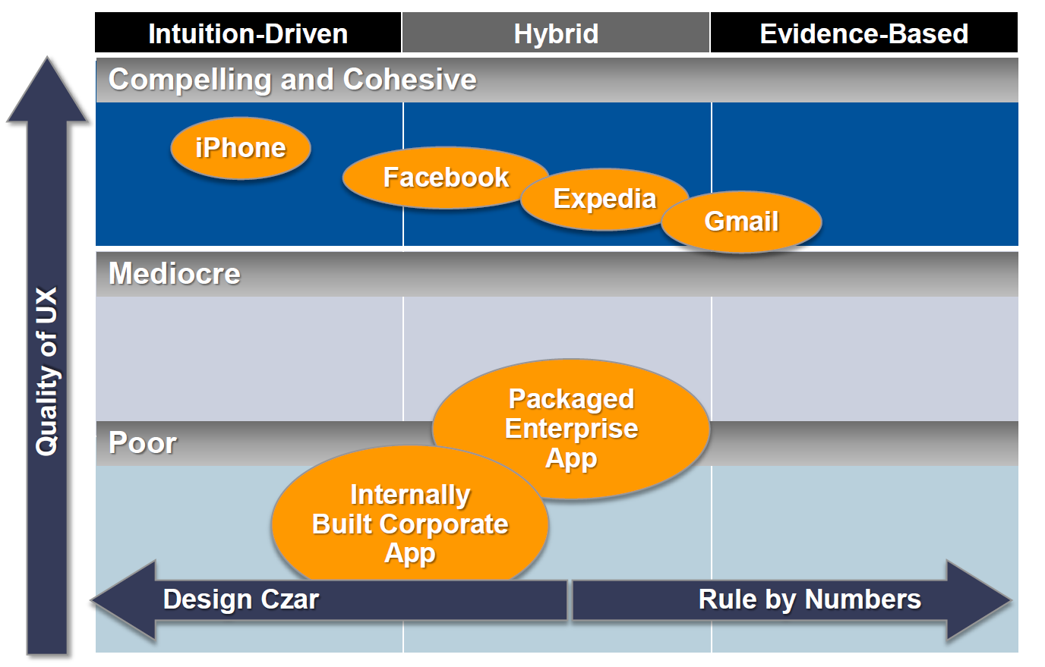
1. Intuitive vs. Evidence UX
Dharmesh Mistry | @dcmistry
Source: Gartner UX Webinar 2015

Slide 19
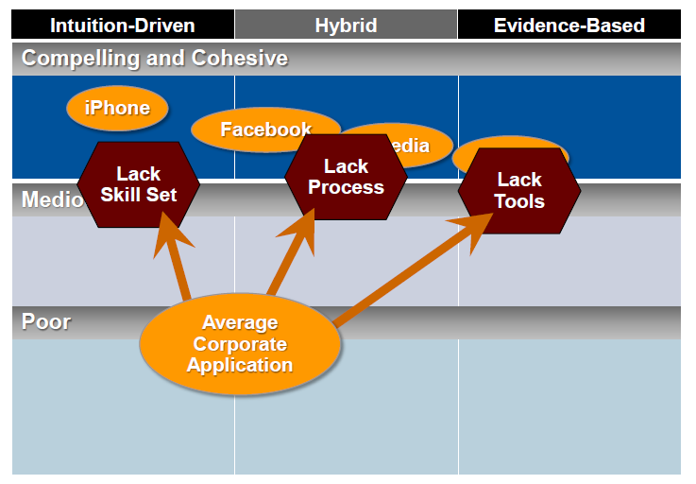
1. Intuitive vs. Evidence UX
Source: Gartner UX Webinar 2015

Slide 20
2. Multi-Channel & Multi-Screen
Deeper integration of digital and physical interactions
“User Context” is key
Targeted and Tailored experiences for different devices
Responsive: Going from mobile-hostile to mobile-optimized approach
Segmenting
applications
Icon created by: Roy Martens, the Noun Project | Severino Ribecca, the Noun Project | Gilad Fried, the Noun Project | Chris McDonnell, the Noun Project
Dharmesh Mistry | @dcmistry

Slide 21
4. UX Engagement Trends
Meaningful
Micro-interactions
Continued evolution of the scroll
Monitor UX
Personalized UX &
Interactive Stories
http://www.freshconsulting.com/top-ui-ux-trends-2015/
Icon created by: Arthur Shlain, the Noun Project | Deivid Sáenz, the Noun Project | Jetro Cabau Quirós, the Noun Project | Sergey Krivo, the Noun Project

Slide 22
3. UX Design Trends
Webfont Type Diversity
Card/ Tiled Navigation
High Impact
Imagery
Material
Design
http://www.freshconsulting.com/top-ui-ux-trends-2015/
Icon created by: Nadir Balcikli, the Noun Project | Kevin Ho,, the Noun Project | Andrew Nolte, the Noun Project | Yarden Gilboa, the Noun Project
Dharmesh Mistry | @dcmistry

Slide 23
Summary
Invest in Emotion along with Effectiveness and Ease
Based on your organization’s structure and resource/ skill availability, implement appropriate UX ideology
Continue to work on multi-channel and multi-screen UX
Be abreast to design and engagement trends; incorporate when aligns with corporate strategy
Dharmesh Mistry | @dcmistry

