Slide 1
To Code or Not to Code
Heather Bauer
Design4Drupal
Friday, July 22, 2016 – 3:45

Slide 2
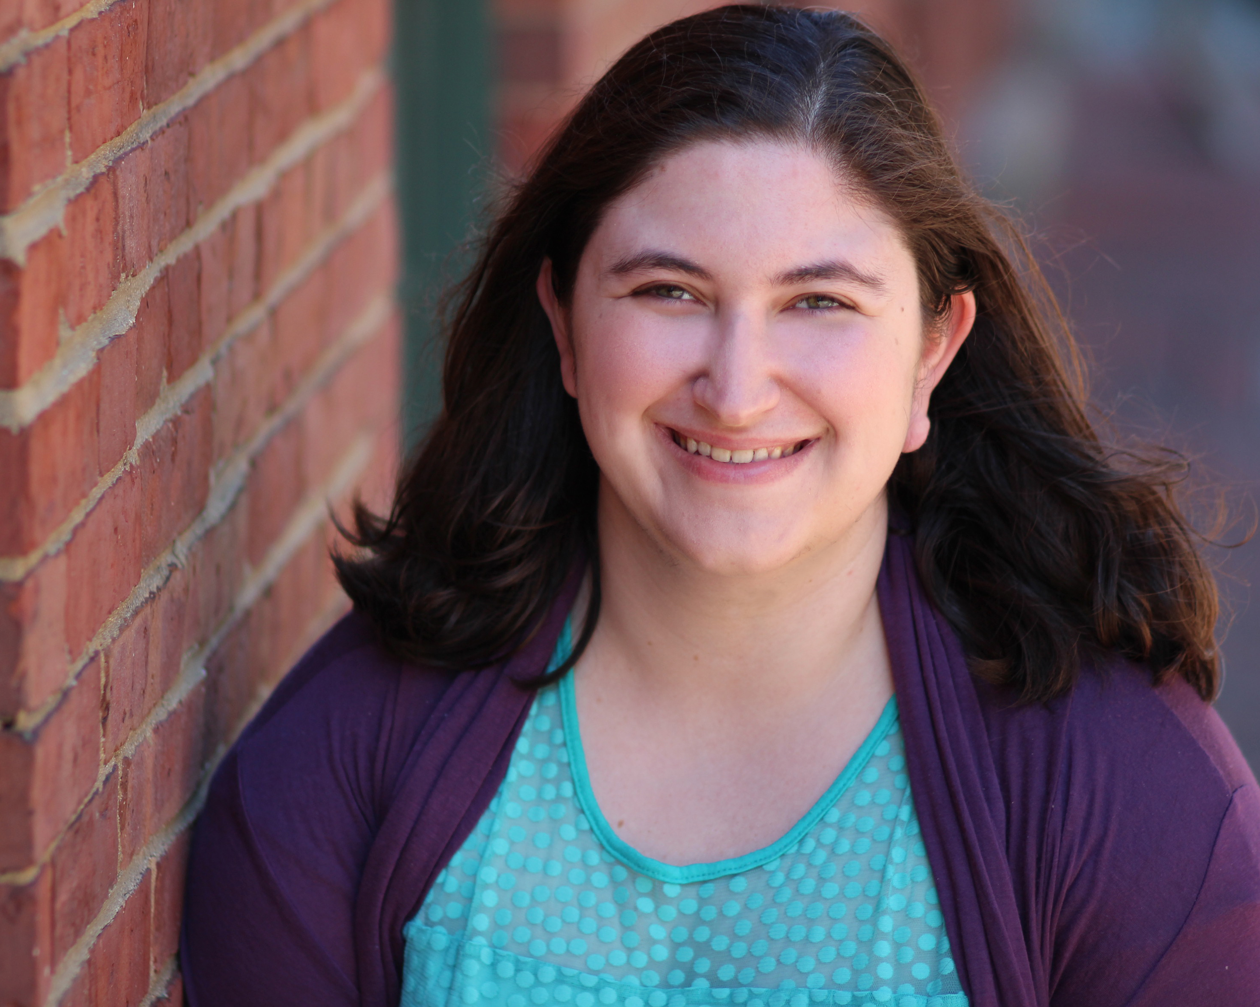
About Me: Heather Bauer
UX Product Specialist at BioRAFT
M.S. in Human Factors in Information Design at Bentley University
Co-Organizer of Drupal Nights
Co-Organizer of Boston Service Jam 2014
Expert in Residence for GA UXD course summer 2014
drupal.org/u/hezzieb
twitter.com/hezzieb524
linkedin.com/in/heathersbauer

Slide 3
About BioRAFT
Enterprise safety, compliance & training software for lab scientists and those that work with them built with Drupal
SaaS, multi-site application.
WE’RE HIRING!
BioRAFT.com
DrupalNights.org
Notes:
Enterprise safety, compliance & training software for lab scientists and those that work with them built with Drupal

Slide 4
Who does this conversation pertain to?
Designers
Project managers
Product managers
UX professionals
Information architects
Technical writers
And…

Slide 5
Do You Code?
None, nada, zilch code?
I know a little HTML and know what an "if statement" does
I might rely on Google but I can get the job done
I write code in my sleep

Slide 6
Should Everyone Code?
Absolutely yes, coding is the new literacy
It will probably make other parts of their job easier
Only if they are really interested
No way, trust the developers to do the code stuff

Slide 7
Survey Results

Slide 8
Pros and Cons to knowing Code

Slide 9
Conclusion

Slide 10
Conclusions

Slide 11
To Code or Not to Code
Slides will be available on drupalnights.org/library
drupal.org/u/hezzieb
twitter.com/hezzieb524
linkedin.com/in/heathersbauer
Heather Bauer
Design4Drupal
Friday July 22nd 2016 – 3:45pm

Slide 12
Survey Results
 | Absolutely yes, coding is the new literacy | It will probably make other parts of their job easier | Only if they are really interested | No way, trust the developers to do the code stuff
I write code in my sleep | 1 | 6 | 5 | 2
I might rely on Google but I can get the job done | 1 | 13 | 5 | 0
I know a little HTML and know what an "if statement" does | 0 | 9 | 13 | 7
None, nada, zilch | 0 | 0 | 2 | 2

