Slide 1
User Research When You Can’t Reach Your Users
Heather Bauer
Drupal Nights
Thursday, October 16, 2014 7:00 PM

Slide 2
About Me: Heather Bauer
Introduction
Junior Usability Specialist at BioRAFT
M.S. Candidate in Human Factors in Information Design at Bentley University
Co-Organizer of Boston Service Jam 2014
drupal.org/u/hezzieb
twitter.com/hezzieb524
linkedin.com/in/heathersbauer

Slide 3
About BioRAFT
Introduction
The BioRAFT platform is a scientific research management system that provides an integrated portal, compliance oversight, and productivity solutions.
SAS, multi-site application.
WE’RE HIRING!
Junior Usability Specialist
BioRAFT.com
DrupalNights.org
Notes:
Enterprise safety, compliance & training software for lab scientists and those that work with them built with Drupal

Slide 4
About You
Usability Professionals
Project Managers
Developers
Other

Slide 5
Agenda
Introduction
Introduction
What is User Experience?
An ideal scenario
How real world differs
What do we do about it
Recap
Resources

Slide 6
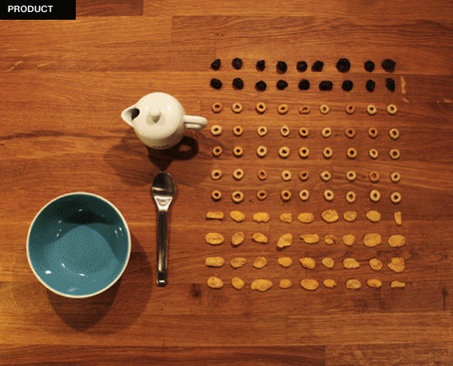
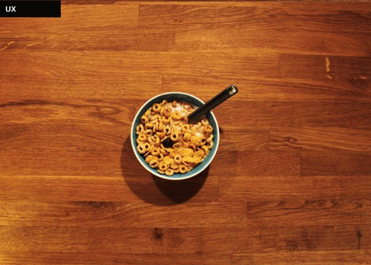
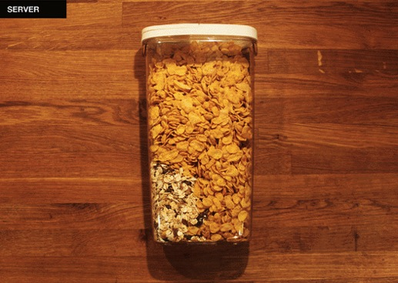
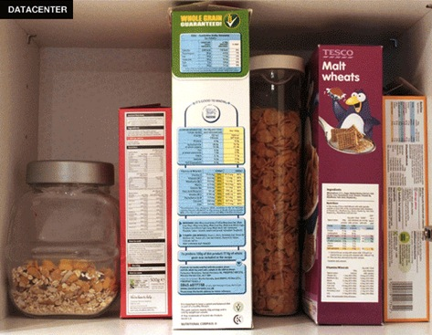
What is UX?
What is UX?
Product
UX
UI
Server
DATACENTER
(source: http://design.org/blog/difference-between-ux-and-ui-subtleties-explained-cereal)

Slide 7
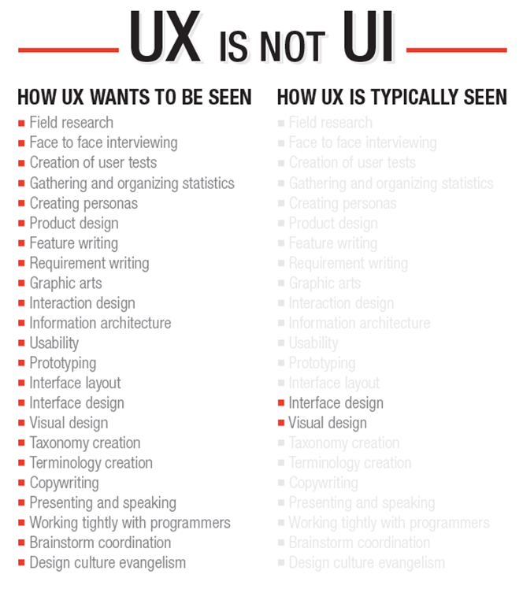
What is UX?
(Source: helloerik.com/ux-is-not-ui)

Slide 8
UX Without User Research…
What is UX?
Is not UX!
UX – U = X

Slide 9
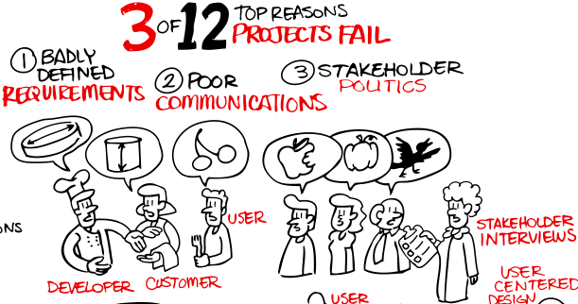
Why Do User Research?
What is UX?
Improve requirements definition
Create clearer communication
Diminish stakeholder politics
(Source: ROI of User Experience. http://www.humanfactors.com/project/index.asp)

Slide 10
Successful User Research
What is UX?
Many different measures of success
Dictated by research goals
(Source: ROI of User Experience. https://www.youtube.com/watch?v=O94kYyzqvTc)

Slide 11
Times Research Saved the Day
What is UX?
$300 Million dollar button
Lego
Chilling milk
2000 Presidential Election
Notes:
http://www.fashiongoesdigital.com/commerce/the-300-million-dollar-button
Goodman, E., Kuniavsky, M., & Moed, A. (2012). Observing the User Experience: A Practitioner's Guide to User Research.

Slide 12
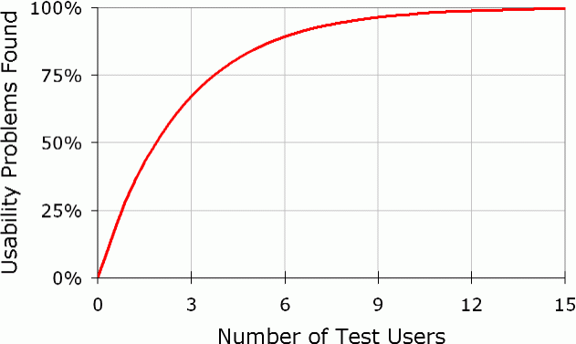
Insights from Users
What is UX?
(Source: http://www.nngroup.com/articles/why-you-only-need-to-test-with-5-users/)

Slide 13
The Ideal
The Ideal

Slide 14
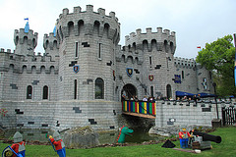
Once upon a time…
The Ideal
Stakeholder buy in
Role of UX understood
Unlimited resources
Experienced team
No shortage of representative participants
Notes:
Once upon a time, in a land far far away, there was a princess who decided that being royal was too boring for her. Therefore the next obvious choice was to become a usability professional. All of her stakeholders completely understood the responsibilities and purpose of UX and the developers always agreed with her suggestions. The available resources were perfect for any solution she thought of and those solutions never created any other problems. There was infinite time for testing and solution implementation. She had an experienced team that complemented each other and represented enough viewpoints that all issues were unearthed. There was never a shortage of willing participants and they were a perfect representative sample of her target audience. They always thought aloud which accurately mapped to every single problem. Releases were always a success and customers were always happy.
Photo by Karen Roe https://www.flickr.com/photos/karen_roe/7615922902

Slide 15
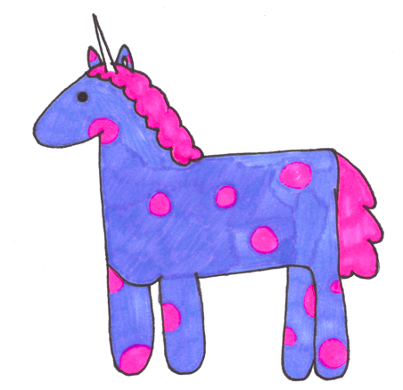
But…
The Ideal
Finding that combination is more elusive than a purple unicorn with pink spots

Slide 16
The Reality
The Reality
Timelines
Budgets
Stakeholder Buy-in
Participants

Slide 17
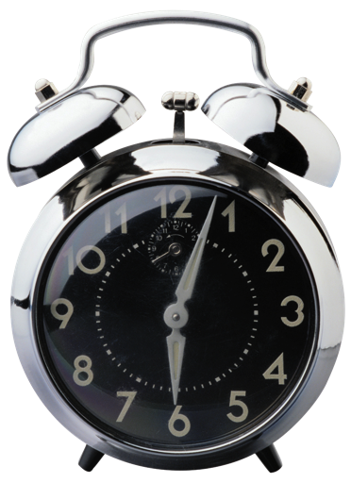
Unlimited Time
The Reality
High priority items become a fire
Low priority items get canceled

Slide 18
Unlimited Budget
The Reality
Not if you’re at a company that wants to stay in business

Slide 19
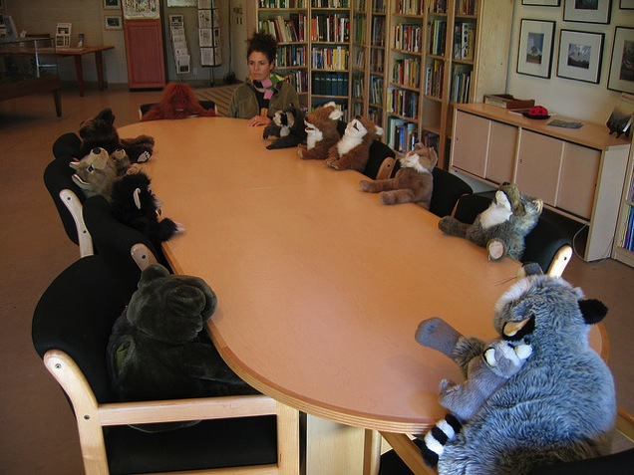
Stakeholder Buy-in
The Reality
Unlisted item in the job description
What is considered part of UX
Why is UX important?
Less of an issue as time passes and rapport grows
Notes:
https://www.flickr.com/photos/tiarescott/69821764

Slide 20
Participants
The Reality
Take availability of participants for granted
Use students when you can’t get real users
What if you require participants with specific knowledge?
7,16-Dibenzyl-1,4,10,13-tetraoxa-7,16-diazacyclooctadecane
Synonym: 1,10-Dibenzyl-1,10-diaza-18crown-6, N,N’-Dibenzyl-4,13-diaza-18-crown6
CAS Number 69703-25-9 | Empirical Formula (Hill Notation) C₂₆H₃₈N₂O₄ | Molecular Weight 442.59

Slide 21
The Solution
The Solution
Google Analytics
User Proxies
Subject Matter Experts
Customer Support
Sales/Marketing
Implementation
Personas
User Journeys
Teamwork

Slide 22
Google Analytics
The Solution
Google Analytics
Audience data & reporting
Using mobile or desktop?
Which browser/OS?
Trace customer path
Requires time to collect enough data

Slide 23
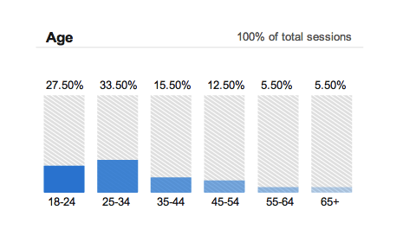
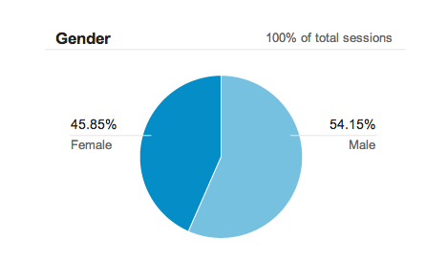
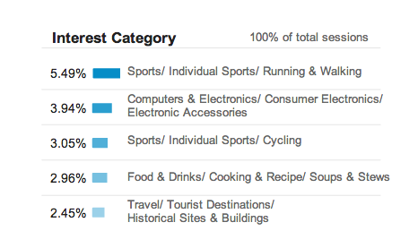
Audience Data
The Solution
Google Analytics
Age
Gender
Interest Category
Only displays for users who have listed their demographic information

Slide 24
Technology Usage
The Solution
Google Analytics
Browser
Operating System

Slide 25
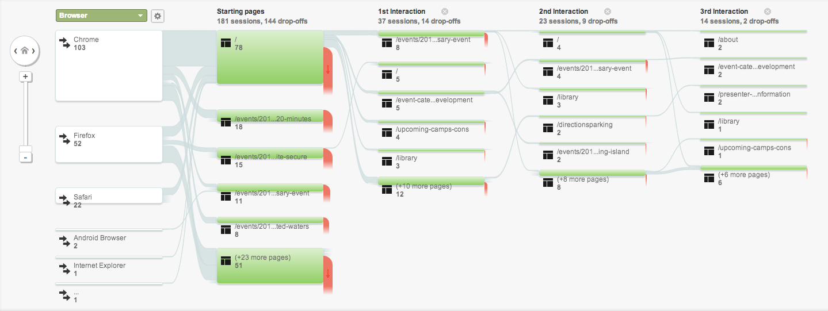
Customer Path
The Solution
Google Analytics
Example stuff

Slide 26
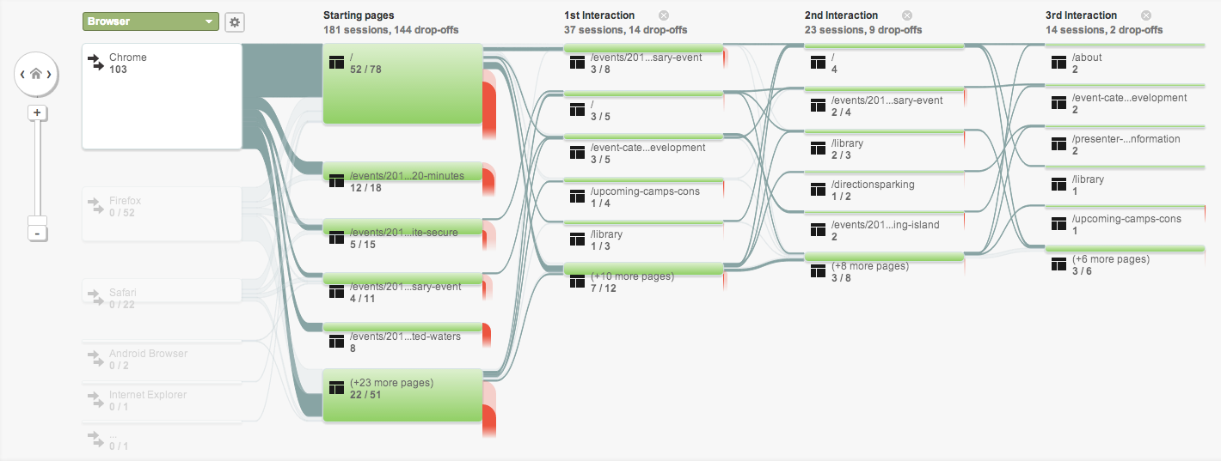
Customer Path
The Solution
Google Analytics
sdf

Slide 27
Google Analytics: Pros/Cons
The Solution
Google Analytics
Pros
Allows us to get data from users without bothering them
See change over time
Inexpensive (in both time and resources)
Cons
Requires time to actually gather data
Do not know the why of what people did

Slide 28
Subject Matter Experts (SMEs)
The Solution
SMEs
Likely were your target audience at some point
Their job is to know the industry
Probably still have friends who are target users
Always happy to tell you stories from the trenches
Notes:
Photo: https://www.flickr.com/photos/guybrariang/7074285227

Slide 29
SME: Pros/Cons
The Solution
SMEs
Pros
Know your users very well
Good anecdotes to get you outside of the sometimes contrived situations others may see your users in
Cons
Already drank the Kool Aid
Amount of time out of industry can impact usefulness of the information

Slide 30
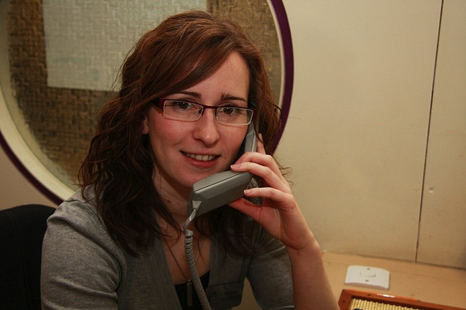
Customer Support
The Solution
Customer Support
They get to talk to the users!
See things from a different perspective
Metrics can identify patterns
Can overemphasize edge cases
Notes:
Photo by Phil Dowsing Creative – customer service shoot – feb 2008
Ex: cats/babies and boxes

Slide 31
Customer Support: Pros/Cons
The Solution
Customer Support
Pros
They get to talk to the users
Different perspective
Useful metrics
Cons
Not trained to be neutral
Overemphasize edge cases
Miss out on the positives

Slide 32
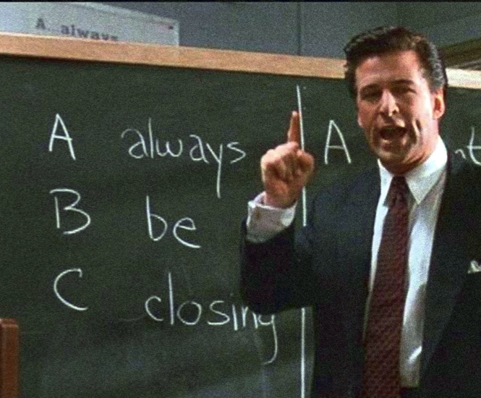
Sales/Marketing Team
The Solution
Sales/Marketing
Objections from potential customers
Have a relationship with decision makers
Used to working conversation to desired topics

Slide 33
Sales/Marketing: Pros/Cons
The Solution
Sales/Marketing
Pros
Hears what prevents people from signing
Used to digging into objections
Cons
Not trained to be neutral
People who are objecting tend to exaggerate the severity of an issue
Only talk to decision makers, not users

Slide 34
Configurations
The Solution
Configurations
What do people have permission to do on site?
What patterns do permissions reveal?
How do permissions change?

Slide 35
Configurations: Pros/Cons
The Solution
Configurations
Pros
Repurpose information we need from the customer anyway
Gives the big picture
Cons
Patterns can be misleading
Permissions may not be restricted enough to reveal patterns

Slide 36
Familiarity with Personas
The Solution
Personas
Newbie
Expert
1
2
3
4

Slide 37
Personas
The Solution
Personas
Brings all the research together
Also suffers some from not talking to users
Can fill in with best guesses
Utilize people who do talk to users to keep the personas updated

Slide 38
What are personas?
The Solution
Personas
Representation of a cluster of users
Wide range of realistic fidelity
Focuses on users’ wants/needs
Facilitates the user hat

Slide 39
Personas and Sales/Marketing
The Solution
Personas
Defining audience
Easier to create “personalized” marketing/sales calls
Allows for Sales & Marketing alignment

Slide 40
Personas and Executives
The Solution
Personas
Quick snapshot of how we see our customers
Company alignment
Informs strategic direction

Slide 41
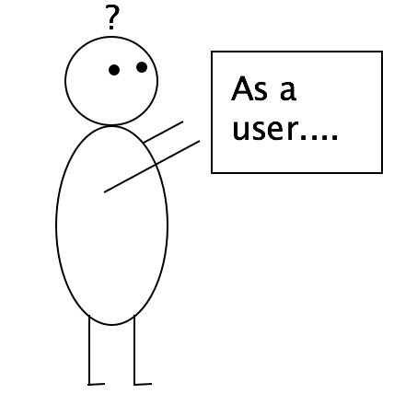
Personas and Product/Dev
The Solution
Personas
Separate ideas into useful or just “cool”
Prioritize new features
QA Testing
Designing for the user, not the developer

Slide 42
Sample Persona
The Solution
Personas
Notes:
https://www.flickr.com/photos/thomashawk/13997782680
https://www.flickr.com/photos/chiropractic/7113650767
https://www.flickr.com/photos/internaz/8059627987

Slide 43
Sample Persona
The Solution
Personas

Slide 44
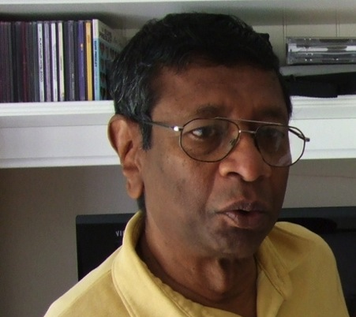
Sample Persona
The Solution
Personas
Tagline
“I want to be a resource to the researchers, not the safety police.”
Position
Environmental Health & Safety Director
Character Traits
Intelligent, Enthusiastic, Bold, Persevering, Achiever

Slide 45
Sample Persona
The Solution
Personas
Role in BioRAFT Rodger manages the Earth EH&S Department and oversees all compliance activity via BioRAFT. He manages teams of auditors, conducts audits himself and attends to a variety of compliance duties as necessary. Most of the time he delegates work to people on his team.

Slide 46
Sample Persona
The Solution
Personas
Tasks in BioRAFT
Oversees all EHS activity on BioRAFT
View Dashboards
View Inspection Logs
Schedule Inspections
Monitor Bio-registrations & Chem-registrations
Monitor Rad-registrations
Oversee Lifesafety

Slide 47
Sample Persona
The Solution
Personas
Common Activities
Monitor all EHS and compliance activity
Maintain Basic Group Information
Manage Biological and Chemical Information
Manage and Approve Biological Registrations
Perform Audits and Inspections
Edit and Manage Equipment
Maintain Institutional Building Documents
Manage Radiological Licenses, Inventory, and Waste Collection

Slide 48
Sample Persona
The Solution
Personas

Slide 49
Sample Persona
The Solution
Personas
(Source: Atlassian “Do Agile Right webinar”)

Slide 50
Sample Persona
The Solution
Personas
(Source: Atlassian “Do Agile Right webinar”)

Slide 51
Sample Persona
The Solution
Personas
Persona rooms at Chrysler
Designers can go into these rooms to get the feel of the driver
Most detailed version of persona – very rare
Notes:
Jenny's living room is the ideal getaway from the busy pace of life of a Jeep Compass owner. Candles flicker on the coffee table, a yoga mat is rolled up in the corner, an Elle magazine is on the couch. "A Sex and the City" DVD plays on TV. A pet fish swims nearby to keep her company.

Slide 52
Personas: Pros/Cons
The Solution
Personas
Pros
Pulls together information from everywhere
Can use your imagination to fill in blanks
Living document that can/should be updated as new information comes in
Cons
Not able to interview users
Creates a false sense of security

Slide 53
Familiarity with User Journeys
The Solution
User Journeys
Newbie
Expert
1
2
3
4

Slide 54
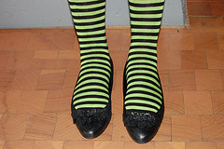
User Journeys
The Solution
User Journeys
Go from putting on your user hat to walking in the users’ shoes
Step beyond personas
How users would tackle a specific task

Slide 55
User Journeys
The Solution
User Journeys
Various levels of fidelity
Highlights pain points
Documents level of frustration from happy to sad

Slide 56
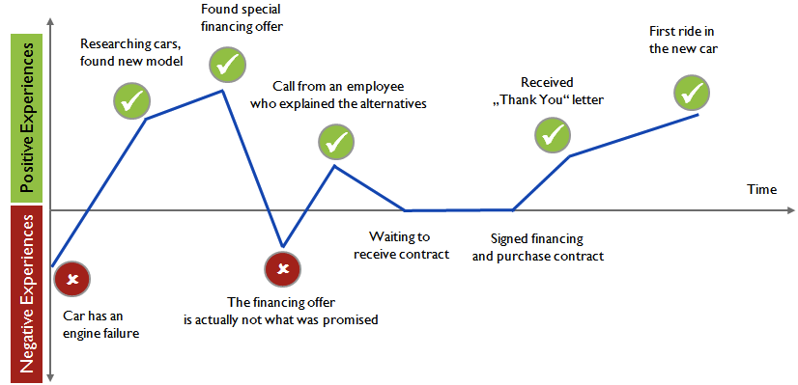
Sample User Journeys
The Solution
User Journeys
Buying a New Car
(Source: Usability Ed)
Notes:
http://usability-ed.blogspot.com/2011/11/mapping-customer-journeys.html

Slide 57
Sample User Journeys
The Solution
User Journeys

Slide 58
Sample User Journeys
The Solution
User Journeys

Slide 59
Sample User Journeys
The Solution
User Journeys

Slide 60
Sample User Journeys
The Solution
User Journeys
(Source: Atlassian “Do Agile Right webinar”)

Slide 61
Sample User Journeys
The Solution
User Journeys

Slide 62
User Journeys: Pros/Cons
The Solution
User Journeys
Pros
Expert Review deliverable
Can use your imagination to fill in blanks
Validate Google Analytics information
Living document
Cons
Not able to interview users
Creates a false sense of security

Slide 63
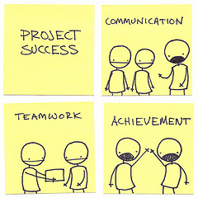
Teamwork
The Solution
Teamwork
Work with your team
Start the conversations you need
Notes:
https://www.flickr.com/photos/kenfagerdotcom/4886342418

Slide 64
How it Comes Together
The Solution
Teamwork
User Proxies
Persona
User Journey
UX Pro

Slide 65
Recap
Recap
Not a perfect world with ideal circumstances
Access to participants is taken for granted
Analytics can give a window to peep in
Utilize your user proxies
Personas & user journeys allow for validation of your second hand research

Slide 66
Resources
Atlassian Do Agile Right Webinar. http://blogs.atlassian.com/2014/01/watch-agile-right-webinar-lessons-learned-atlassian-product-manager
How to Create User Personas. http://www.huffingtonpost.com/john-haydon/user-personas-websites_b_1793594.html
Pinterest. http://www.pinterest.com/robertleotta/user-journeys/
ROI of User Experience. http://www.humanfactors.com/project/index.asp
User Journeys – The Beginner’s Guide. http://theuxreview.co.uk/user-journeys-beginners-guide/
User Story. http://searchsoftwarequality.techtarget.com/definition/user-story

Slide 67
User Research When You Can’t Reach Your Users
Slides will be available on drupalnights.org/library
drupal.org/u/hezzieb
twitter.com/hezzieb524
linkedin.com/in/heathersbauer
Heather Bauer
Drupal Nights
Thursday, October 16, 2014 7:00 PM

