Slide 1
Foundation & Drupal 8
Theme and Load Responsively
Notes:
Didn’t know exactly what this was about until I finished it - but I knew I wanted it to be about Foundation.

Slide 2
What we’ll cover
Introductions
Frameworks
Drupal 8 Theme (rapid)
Foundation (focus)
Examples

Slide 3
Introduction
Your elevator speech goes here...
Name?
What do you do?
Do you use a Framework?
Notes:
Scott teaches programming to 3rd - 5th graders for fun. He is currently the Web Development Manager for Integrated Computer Solutions with a web team distributed across the world. He has been managing teams working in Drupal for six years and web many years longer. He has built systems for large Drupal infrastructures at Harvard University and Bentley University.
Most importantly he’s a Dad, has an amazing wife, a grumpy cat and loves to ride his bike.
i’m not a front end developer. i manage teams of developers. I do write lots of code.
why am i here talking about painters and hopefully responsive frameworks? and why do i care about a framework?
because i care most about the relationship between the user and the page we render.
my team doesn’t build sites: we deliver experiences. that’s what the people that pay us want us to do. whether they know it or not.
i deliver user experiences. developer experiences. marketing experiences.
these experiences build relationships.
so in building that experience. i love the 10% at the end. love to get it really good.
i love when the user gets what they want. i love when the user doesnt think.
as a manager i constantly bring it back to the user experience. the good.
i’m sorry. tonight we’re not going to talk about good. we’re setting up to get to good. we’re setting the foundation for good.
all right. where do we start?
we start by understanding what eats our time. what slows Developers down?
- lack of content & assets
- dev and deployment process
- testing and QA
- short term development choices & communications between other developers.
- remaking what we make every site: forms, buttons, sliders
I’m going to focus on the last 2:
- short term development choices & communications between other developers = standards
- remaking what we make every site: forms, buttons, sliders = tools
Standards and Tools
i started out writing html, css before y2k, i create custom CMS systems (CF&Perl), then Drupal - backend, front end, site building.
And as the web evolved I realized that I needed was tools like Drupal and Foundation to more efficiently create the base of my work.
5 years ago I started at Bentley U we had sites in Java, CF, D5, d6, d7 - we were attempting to migrate 84 sites (the whole university) to D7. It took us months to migrate 1 site.
And I wanted us to support the mission of the University.
We did a couple of things - we fixed our Process, agreed upon Standards and Tools
We chose D7 + Zen Theme as our shared Framework
Foundations does the same as Drupal on the Front End
We will focus on Standards and Tools to rapid development
I chose Drupal 8 because I needed to learn it and it’s a great opportunity to start new.
Let’s set it up.

Slide 4
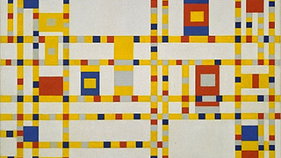
Notes:
We have gone from no CMS to CMS driven by content
Driven to more complex responsive layout
Structure = framework

Slide 5
Which Framework?

Slide 6
Frameworks
Across the Web
Bootstrap
50 %
HTML5 Boilerplate
Drupal Themes
Classy 8.0.0-beta13 Bootstrap 8.x-3.x-dev Omega 8.x-5.x-dev Zen - None Foundation 8.x-5.x-dev HTML 5 Boilerplate (no 8.x)
38 %
Foundation
5 %

Slide 7
Bootstrap v. Foundation
Bootstrap
Foundation
mobile-first 12-column grid consisting of rows and columns
4 pixel-based media query breakpoints
LESS
<div class="container"> <div class="row"> <div class="col-sm-4"> <!-- content -->
mobile-first 12-column grid consisting of rows and columns
5 em-based media queries
SASS
<div class="row"> <div class="medium-4 columns"> <!-- content -->
Notes:
Taking a step back to look at some code - all this talk is boring.
Anyone using either?

Slide 8
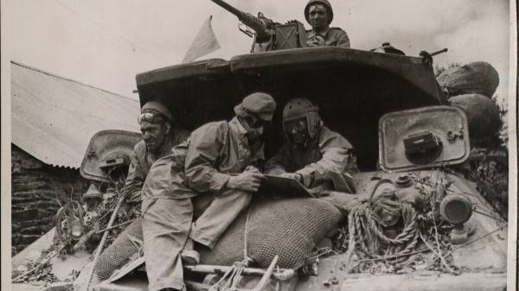
D8 + Foundation 5

Slide 9
Requirements
PHP 5.5.9 for D8
jQuery 1.10 +
SASS Compiler (Compass)
Foundation 1.0.3 gem or higher
Node.js & Grunt.js (for rapid theme development).
Notes:
Okay because D8 already exceeds this

Slide 10
D8 Theme
Notes:
Create a D8 Theme from Starter
Rename
Regions
Theme Functions - unset core styles
Add libraries
SASS

Slide 11
8 ready?
Start now on D8 sites if
Sites that rely mainly on the expanded functionality provided by Drupal 8 core alone.
Projects that will take months of development time.
Sites for which the benefits of Drupal 8's outweigh the effort needed to port (or work around) contributed modules that do not yet have Drupal 8 versions.
Time to start, kids!
says dries.

Slide 12
Create D8 Theme
Create & Configure Theme
Review Twig
Review SASS

Slide 13
Starter Theme
Copy Starter Theme Configure
THEME.info.yml
add libraries
THEME.libraries.yml
add CSS/JS
drupal_add_js/css gone
core library
THEME.theme = template.php
add remote file css_alter
services.yml
show render html
debug configuration
Notes:
I did a lot of this in advance to spare you my incompetence.
Readme.txt
Go down info.yml
libraries.yml
.theme is your new template.php
services for debug
show underscore and backbone included
function theme_name_css_alter(&$css) {
$bootstrap = 'https://maxcdn.bootstrapcdn.com/bootstrap/3.3.5/css/bootstrap.
min.css';
$css[$bootstrap] = array(
'data' => $bootstrap, 'type' => 'external',
); }

Slide 14
Base Theme
Z_F.info.yml
regions
Z_F.libraries.yml
review CSS/JS
Z_F.theme
sidebar 326 - 344
Notes:
I did a lot of this in advance to spare you my incompetence.
Readme.txt
Go down info.yml
libraries.yml
.theme is your new template.php
services for debug
show underscore and backbone included

Slide 15
Twig
Templates in Base Theme
Page.html.twig
page--front.html.twig
Notes:
Show how HTML is rendered in Twig file
CONFIG
debugging: https://www.drupal.org/node/1903374
Review Base Theme
zurb_foundation.theme page for sidebar 326 - 344

Slide 16
SASS
SCSS
folders
variables
mixins
config.rb
use base theme or sass to pick and choose css, js
Notes:
go thru scss folder
style.scss
base
variable
elements
mixins

Slide 17
/* SCSS */ /* SASS */
$blue: #3bbfce; $margin: 16px; .content-navigation { border-color: $blue; color: darken($blue, 9%); } .border { padding: $margin / 2; margin: $margin / 2; border-color: $blue; }
similar to regular CSS than the older SASS approach
$blue: #3bbfce $margin: 16px .content-navigation border-color: $blue color: darken($blue, 9%) .border padding: $margin / 2 margin: $margin / 2 border-color: $blue
sassmeister

Slide 18
Zurb Foundation
“The most advanced responsive front-end framework in the world.”
-Foundation web site | Foundation Sites

Slide 19
What is Foundation?
Foundation is a responsive front-end framework made by ZURB, a product design company in Campbell, CA.
Foundation is mobile-first. Code for small screens first, and larger devices will inherit those styles. Customize for larger screens as necessary.
Foundation JavaScript was designed to work with jQuery right out of the gate. CSS or SASS (SCSS)

Slide 20
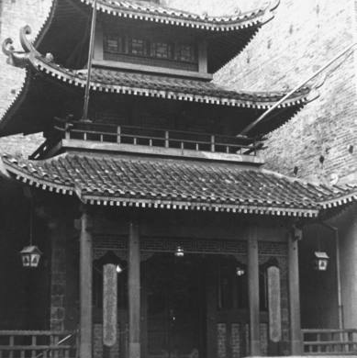
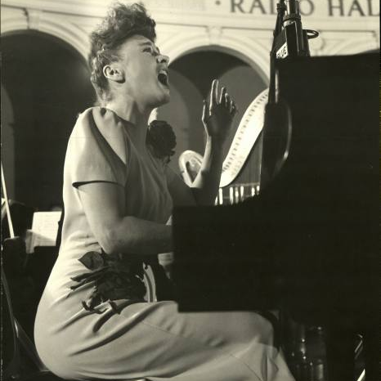
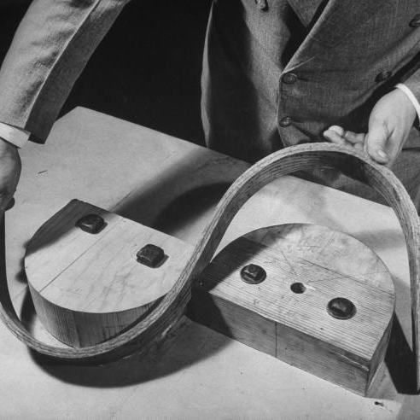
Features
Structure
Navigation
Media
Forms, Buttons
Media Queries
Visibility
Grid
Interchange
Off-Canvas
Top Bar
etc
Slider
Flex Video
Icons
Typography
Callouts
Content
Accessibility
Notes:
What Foundation offers you .

Slide 21
Media Queries 5
// Small screen (max-width: 40em) { } 640px,
// Medium screens @media only screen and (min-width: 40.063em) and (max-width: 64em) { } /* min-width 641px and max-width 1024px // Large screens @media only screen and (min-width: 64.063em) and (max-width: 90em) { } /* min-width 1025px and max-width 1440px, use when QAing large screen-only issues */ // XLarge screens @media only screen and (min-width: 90.063em) and (max-width: 120em) { } /* min-width 1441px and max-width 1920px, use when QAing xlarge screen-only issues */ // XXLarge screens @media only screen and (min-width: 120.063em) { } /* min-width 1921px, xxlarge screens */

Slide 22
Examples

Slide 23
Examples
Basic Foundation Elements
A complex homepage
Slick Slider
Interchange
Kitchen Sink
Clearing/ Lightbox
Pizza
Foundation Documentation
Notes:
Foundation Site
Visibility
block Grid
Utility Class
Acccessibility

Slide 24
EVEN MORE!
Foundation

Slide 25
What else is Zurb up to?
Zurb Ink
Quickly create responsive HTML emails that work on any device & client. Even Outlook.
Zurb Apps
The first front-end framework created for developing fully responsive web apps.
Foundation 6: Prototype to Production
http://zurb.com/article/1403/foundation-6-prototype-to-production
Zurb makes Notable
Playground
Quickly create responsive HTML emails that work on any device & client. Even Outlook.

Slide 26
Review

Slide 27
What we covered
Frameworks: Bootstrap v Foundation
Created Drupal 8 theme
Starter, SASS, Twig
Foundation Funn! Grids, Interchange

Slide 28
Anything Else?

